Slide 2

Cement Integrity

Slide 3
Overview
What Is Cement Integrity?
Integrity Threats
Cement Design Approaches
Cement Integrity Evaluation Tools
Emerging Technologies
Final Thoughts

Slide 4
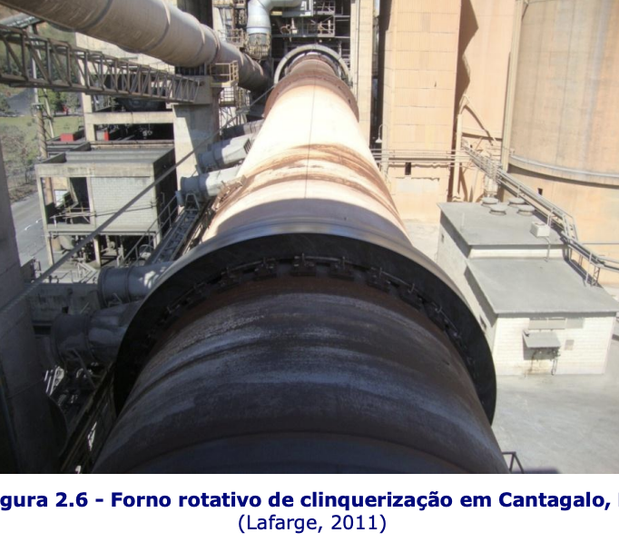
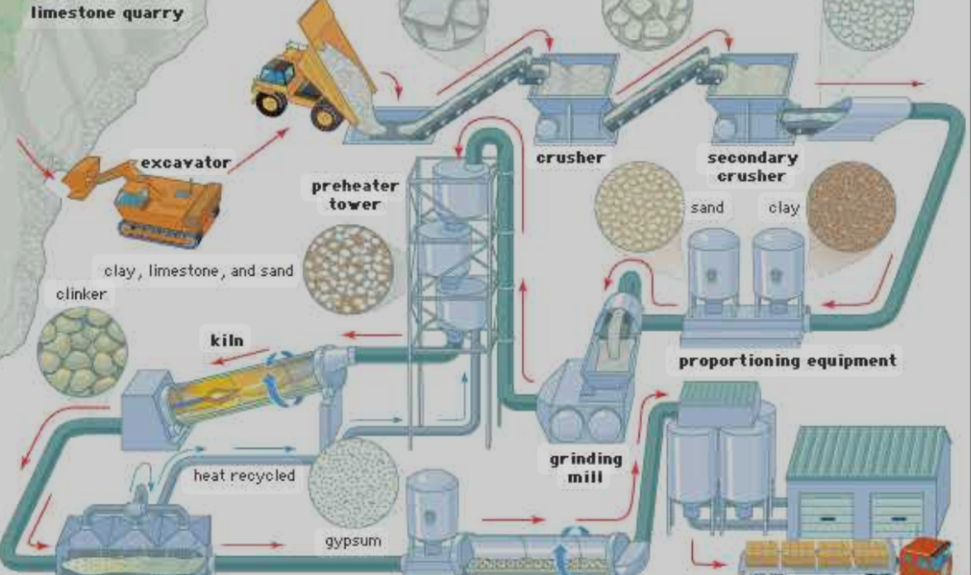
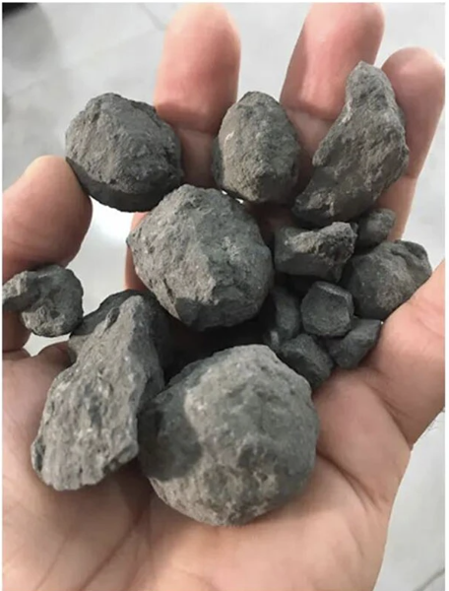
Cement Manufacturing of Portland Cement
Rotary Kiln (±1450 º C)
Clinker
Joseph Aspdin, 1824
Notes:
Fineness of cement has a great effect on the rate of hydration and hence the rate of gain of strength.
Fineness of cement increases the rate of evolution of heat.
Finer cement offers a great surface area for hydration and hence faster the development of strength.
Increase in fineness of cement also increases the drying shrinkage of set cement and hence creates cracks in structures.
Excessive fineness requirement increases cost of grinding.
Excessive fine cement requires more water for hydration, resulting reduced strength and durability.
Fineness of cement affects properties like gypsum requirement, workability of fresh set cement & long-term behavior of structure.
Approximately 95% of cement particles are smaller than 45 micrometers, with the average particle around 15 micrometers.
Óleo combustível, carvão mineral e mais recentemente coque de petróleo

Slide 5
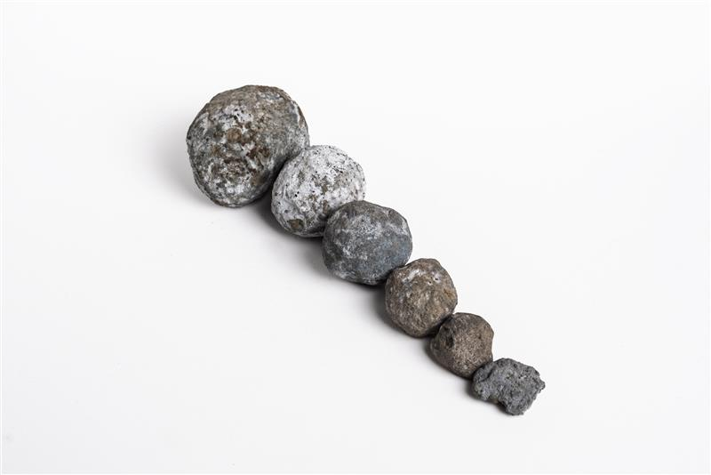
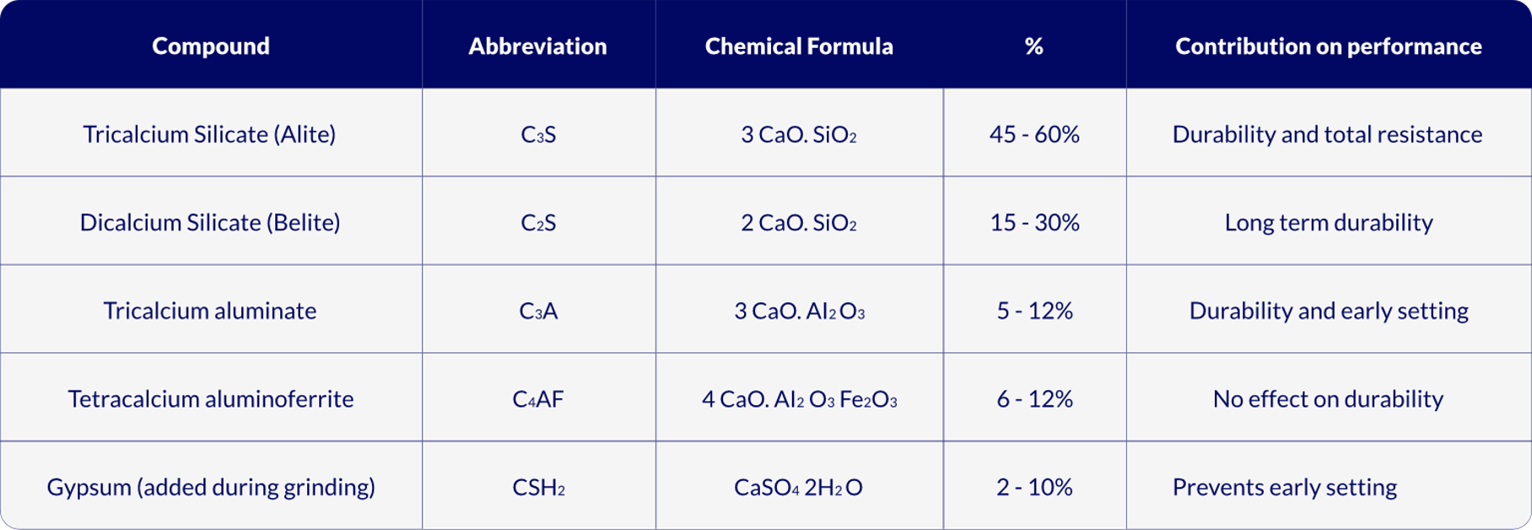
Class G Cement Clinker Composition

Slide 6
Heatflow During Cement Hydration
% cement hydration
heatflow
Acceleration
Desacceleration
Diffusion
40-50%
hydrated cement
Pre-induction
period
(2% to 3% Hydration)
Heatflow
% Hydrated cement
Induction Period
(silicates have low reactivity during this period)
Setting and
Hardening
min
hours
days
Time

Slide 7
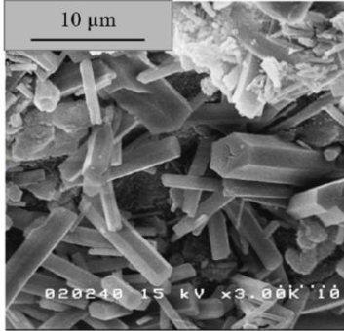
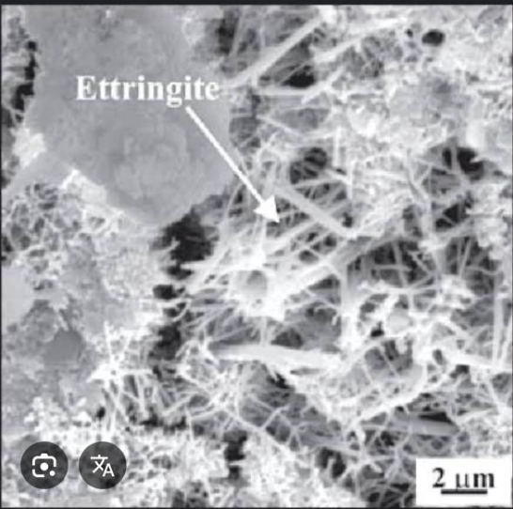
What is Set Cement?
Ettringite is formed during the initial hydration of cement when C₃A reacts with gypsum (CaSO₄.2H₂O) in the presence of water:
Ca₆Al₂(SO₄)₃(OH)₁₂.26H₂O
It controls thickening time and cement setting time.
Compound | Chemical formula | Abbreviation | Typical Mass (%) | Contribution on performance
Tricalcium aluminate | 3CaO·Al₂O₃ | C₃A | 5 -12% | Durability and early setting

Slide 8
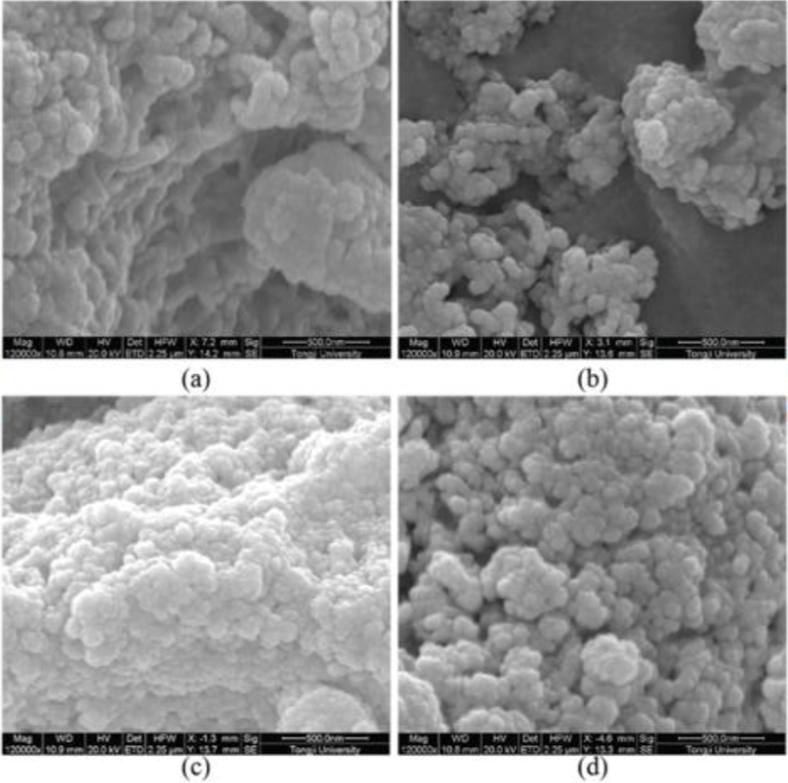
What is Set Cement?
C-S-H (Calcium Silicate Hydrate) is the main phase which keeps the cement particles binded together, providing cohesion and resistance. It does not have a defined chemical formula and is amorphous. It is formed from the hydration of Portland cement silicate phases:
2C₃S + 6H → C₃S₂H₃ + 3 Ca(OH)₂
2C₂S + 4H → C₃S₂H₃ + Ca(OH)₂
It controls cement permeability (gelled structure which fills the pore spaces), besides resisting to chemical attacks, and improve cement durability over cement long term life.
Compound | Abbreviation | Chemical Formula | Typical Mass (%) | Contribution on performance
Tricalcium silicate (Alite) | C₃S | 3CaO·SiO₂ | 45–60% | Durability and total resistance
Dicalcium silicate (Belite) | C₂S | 2CaO·SiO₂ | 15–30% | Long term durability

Slide 9
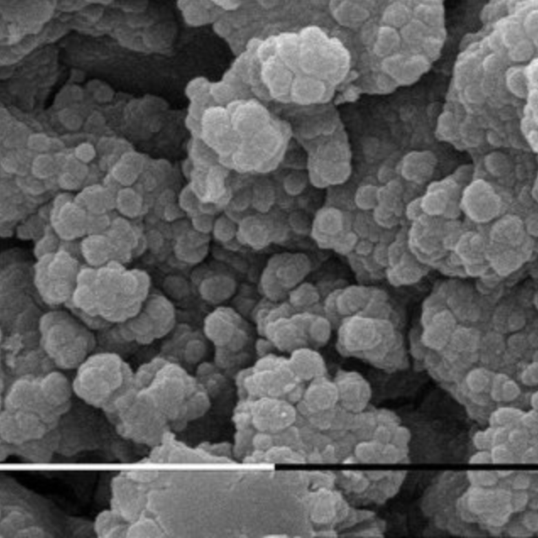
What is Set Cement?
Ca(OH)₂ (Calcium Hydroxide) is byproduct of Portland cement silicate phases hydration:
2C₃S + 6H → C₃S₂H₃ + 3 Ca(OH)₂
2C₂S + 4H → C₃S₂H₃ + Ca(OH)₂
It is also called hydrated lime or portlandite.
It provides alcalinity (high pH) to the pore solution, helping metal protection against corrosion in harmful environments. It is also one of the main reactants to CO₂ attack (carbonation reaction).
Compound | Abbreviation | Chemical Formula | Typical Mass (%) | Contribution on performance
Tricalcium silicate (Alite) | C₃S | 3CaO·SiO₂ | 45–60% | Durability and total resistance
Dicalcium silicate (Belite) | C₂S | 2CaO·SiO₂ | 15–30% | Long term durability

Slide 10
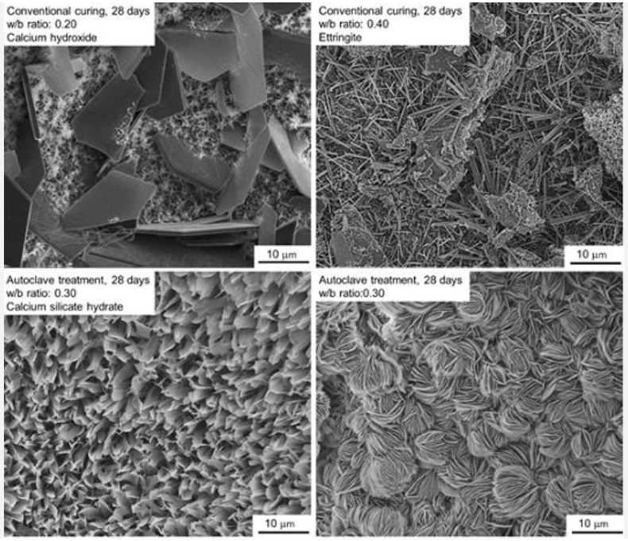
What is Set Cement?
The main products generated by the cement hydration process are the Calcium Silicate Hydrate gel – CSH – and the Calcium Hydroxide – Ca(OH)₂.
CSH is semi-amorphous material, similar to a gel, which make up approximately 70% in weight of hydrated cement and is the main particles binder.
Ca(OH)₂ is crystalline and make up approximately 15 to 20% in weight of hydrated cement.
Nelson e Guillot, 2006)

Slide 11
What Is Cement Integrity?
Key Aspects:
Mechanical strength
Bonding (casing and formation)
Resistance to downhole environments
Long-term chemical durability

Slide 12
Key Integrity Threats
Key Chemical Degradation (CO₂, H₂S, Salts)
Microannuli and Stress-Induced Cracks
Gas Migration and Fluid Channels
Cement Aging and Retrogression
Poor Mud Removal and Placement Practices

Slide 13
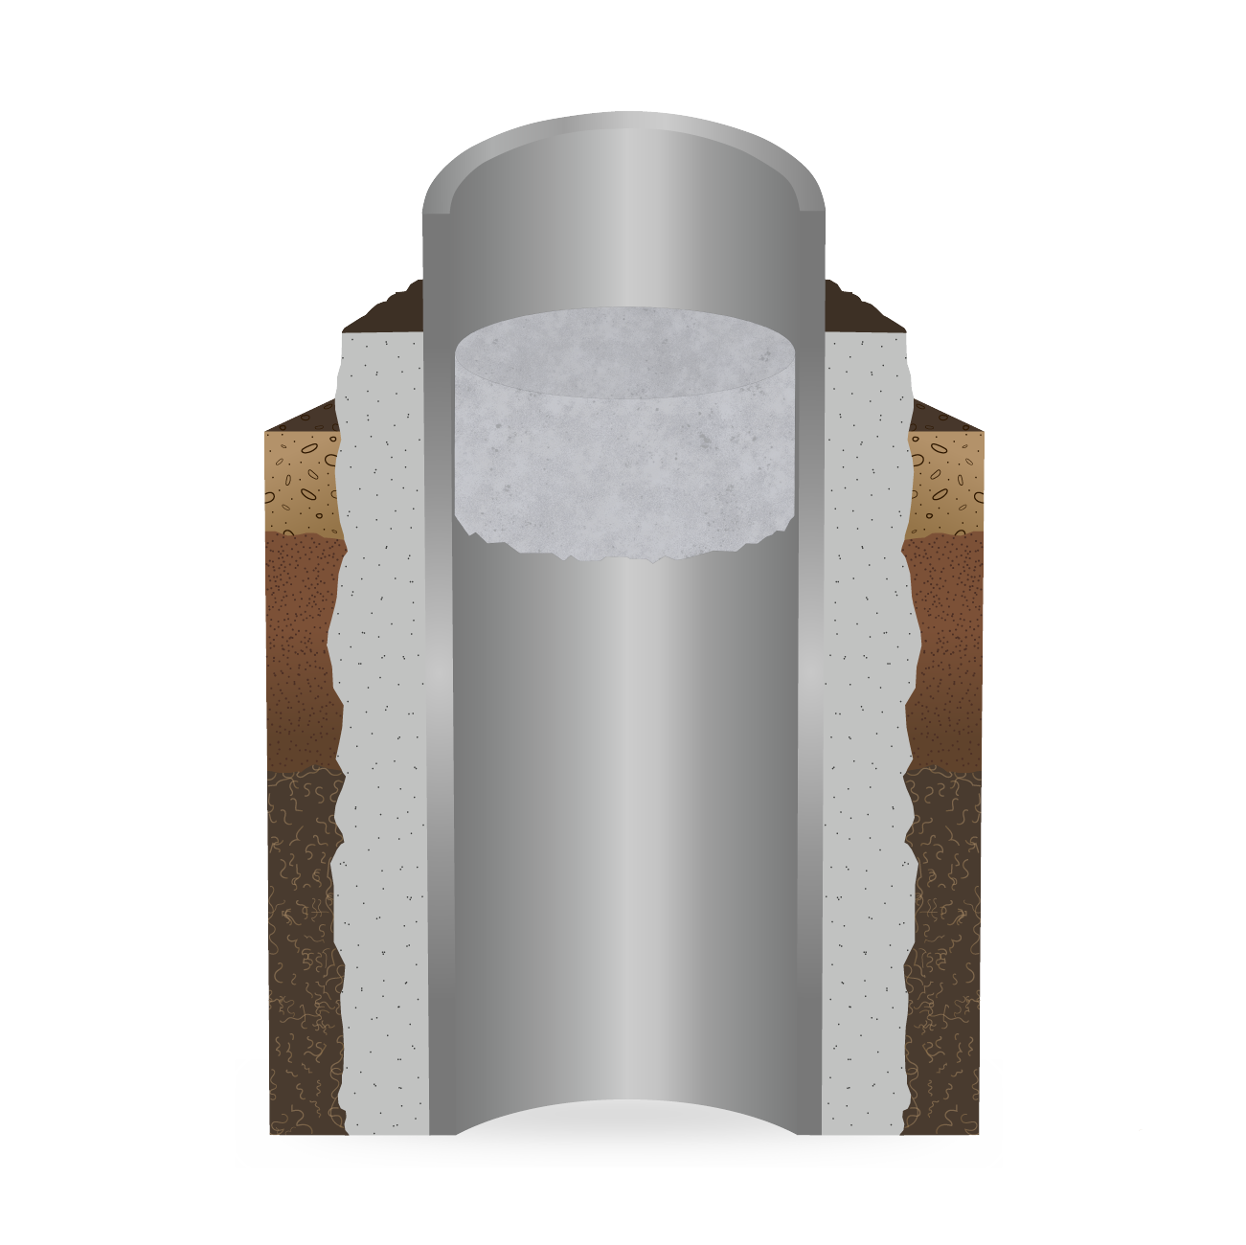
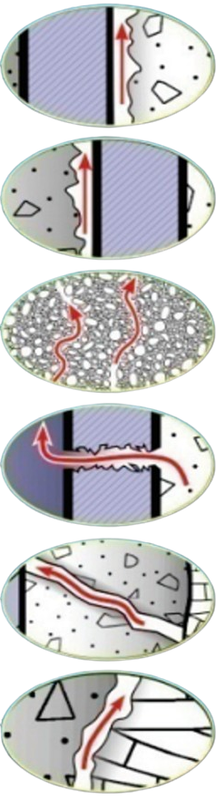

Integrity Tests: Potential Leakage Pathways
Well Casing
a
Cement Fill
Cement Well Plug
Formation Rock
b
c
d
e
f
Gasda et al., 2004 and 2005
Notes:
Several potential leakage pathways can occur along cased holes and/or abandoned wells as illustrated in Figure 3 (Gasda et al., 2004 and 2005). These include leakage between the cement and the outside of the casing (Fig. 3a), between the cement and the inside of the casing (Fig. 3b), through the cement plug (Fig. 3c), through deterioration (corrosion) of the casing (Fig. 3d), deterioration of the cement in the annulus (cement fractures) (Fig. 3e), and leakage in the annular region between the formation and the cement (Fig. 3f).

Slide 14
Integrity Threat : HPHT Conditions
Mitigation: Silica, pozzolans, optimized W/C ratio
Standards: API RP 10B-5, ISO 10426-5

Slide 15
Integrity Threat : HPHT Conditions
1
2
3
C₃S₂H₃ becomes unstable and transforms itself in a hydrated C₂S of low resistance.
The crystallization degree of the hydrated byproducts is limited, and the dehydration of crystals further deteriorate the compressive strength of cement.
Increase of porosity and formation of microcracks compromise the structural integrity of set cement.

Slide 16
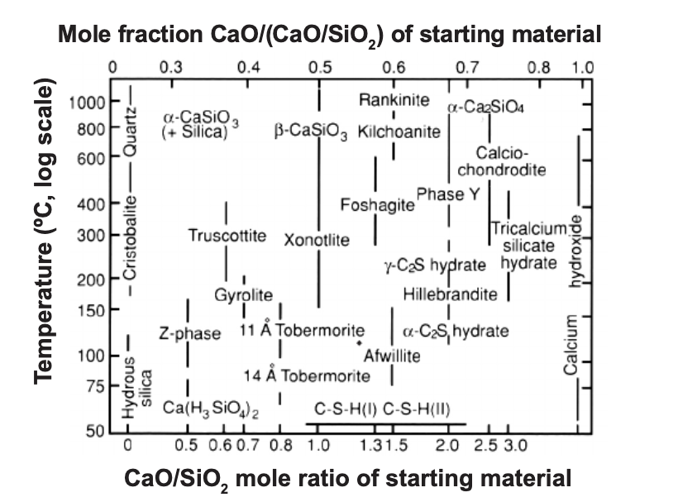
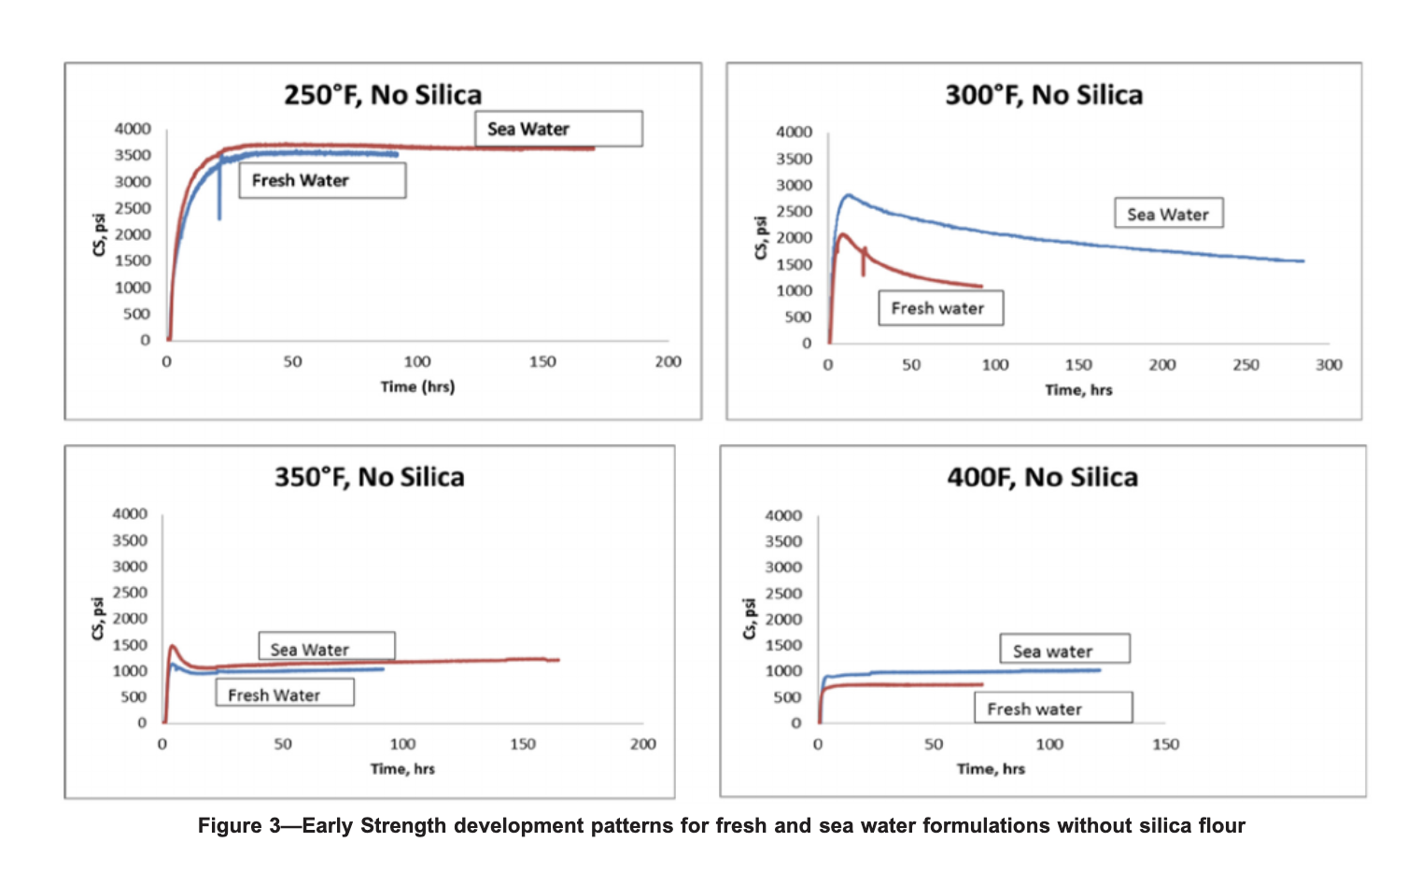
Integrity Threat : HPHT Conditions
Figure 1: Phase changes in Portland cement submitted to elevated temperatures.
Figure 2: Early strength development patterns for fresh and sea water formulations without silica flour.

Slide 17
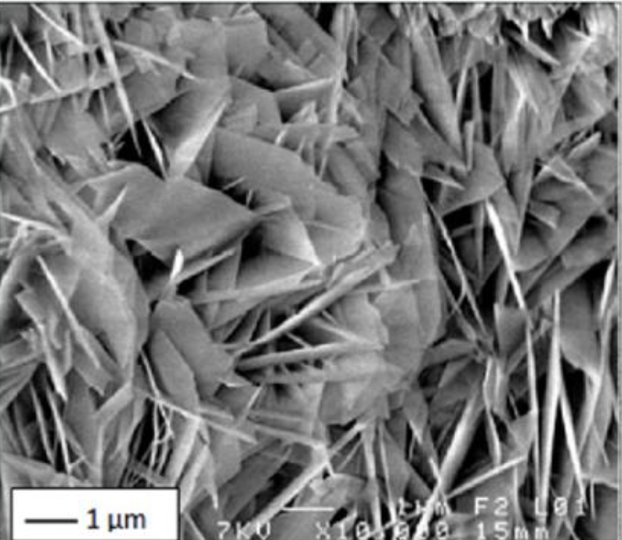
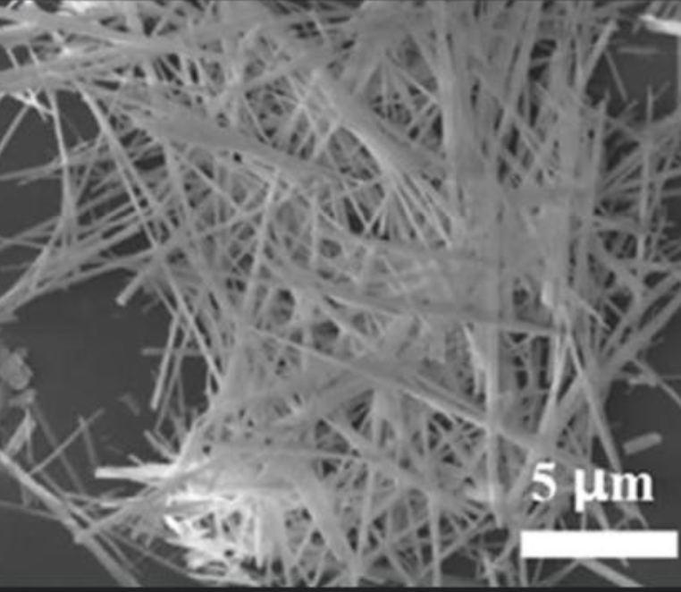
Integrity Threat : HPHT Conditions
Tobermorite
Xonotlite
Xonotlite is formed at higher temperatures than Tobermorite

Slide 18
Integrity Threat : CO₂ and H₂S and HCl Attack
Reactions: CH + CO₂ → CaCO₃, then leaching
Mitigation: CO₂-resistant cements, Sulfate resistant cements, fly ash, geopolymer, MgO, latex-modified

Slide 19

Integrity Threat : CO₂ Attack
CO₂ + H₂O → H₂CO₃ (carbonic acid)
H₂CO₃ + Ca(OH)₂ → CaCO₃ + 2H₂O
C-S-H and/or crystalline phases + H2CO3 → CaCO3 + SiO2 (gel) + H2O
CaCO3 + H2CO3→Ca(HCO3)2

Slide 20
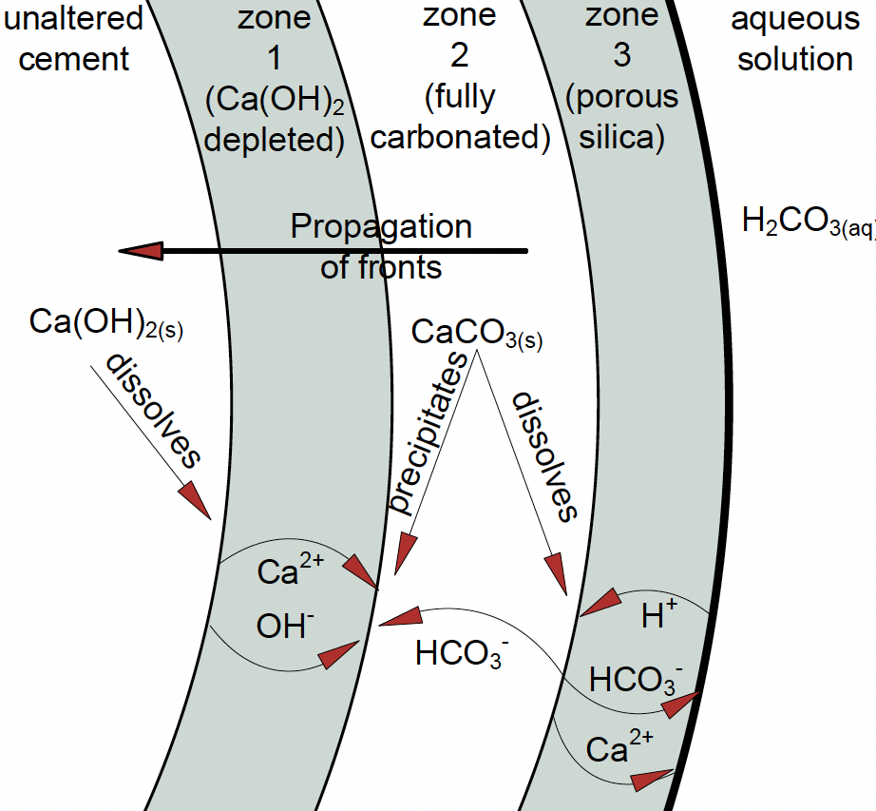
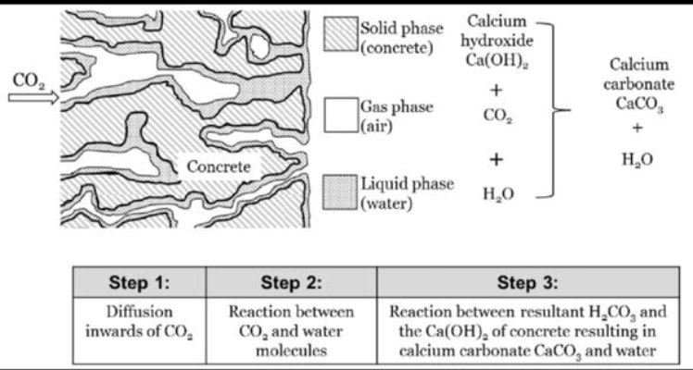
Integrity Threat : CO₂ Attack
The dissolution and calcium migration and formation of distinct zones in the set cement.
(Kutchko et al., 2007)

Slide 21
Integrity Threat : H₂S Attack
H₂S + Ca(OH)₂ → CaS + 2H₂O
CaS + 2H₂O + CO₂ → CaCO₃ + H₂S↑
Monosulfates react with C₃A, forming expansive crystals:
Ettringite: C₃A + 3(CaSO₄·2H₂O) + 26H₂O → C₆AŠ₃H₃₂ (3CaO·Al₂O₃·CaSO₄·12H₂O)
Gypsum (CaSO₄·2H₂O): Can also form if excess sulfate reacts with calcium hydroxide (portlandite)

Slide 22
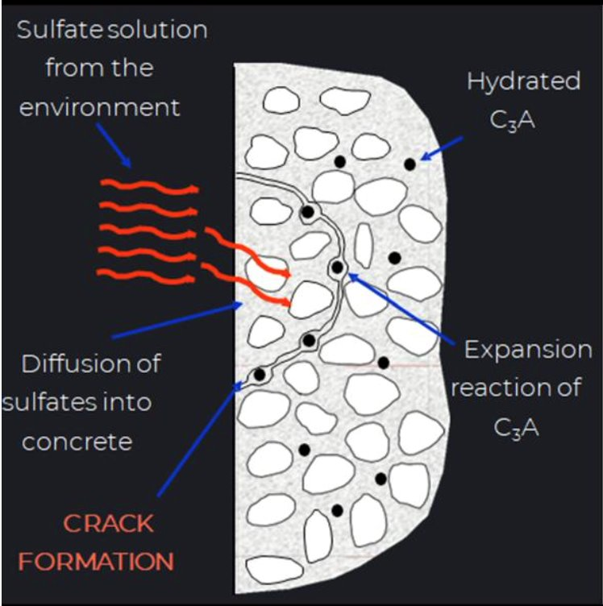
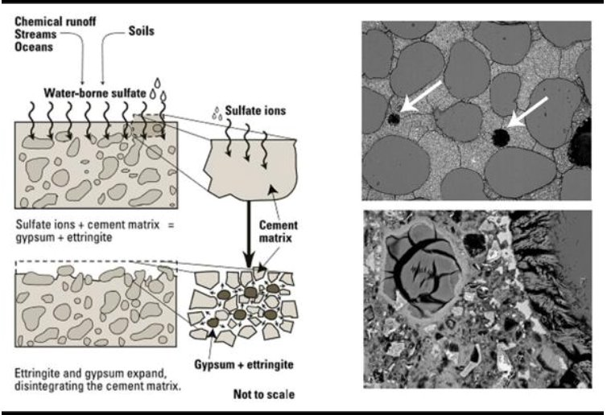
Integrity Threat : H₂S Attack

Slide 23
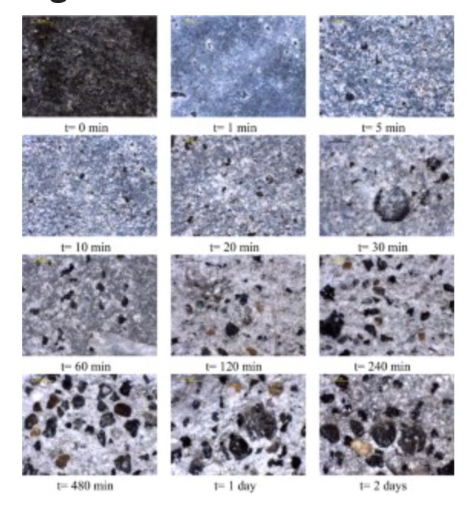
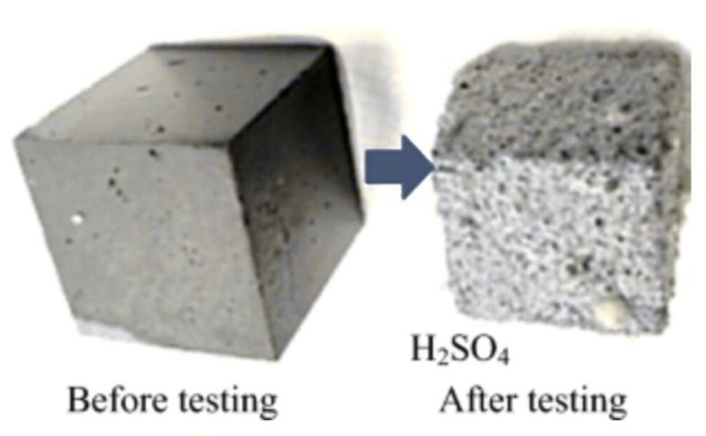
Integrity Threat : H₂S Attack

Slide 24
Integrity Threat : HCl Attack
2HCl + Ca(OH)₂ → CaCl2 + 2H2O
CSH + 2HCl → SiO2. xH2O (gel) + CaCl2
Reaction with Ettringite : C₆AŠ₃H₃₂ + 12HCl → AlCl3 + CaCl2 + byproducts
CaCO3 + 2HCl → CaCl2 + CO2↑ + H2O

Slide 25
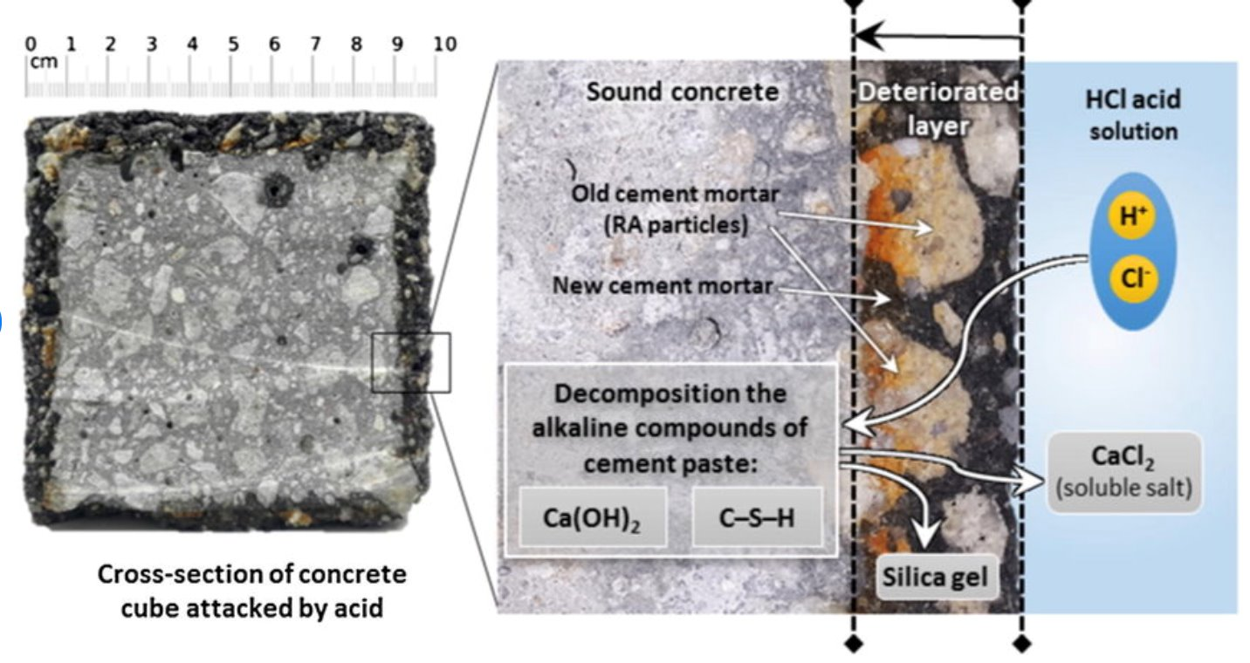
Integrity Threat : HCl Attack
Notes:
Recycled aggregates

Slide 26
Integrity Threat : CO₂ and H₂S and HCl Attack
Dissolution:
Loss of Ca(OH)₂ reduces alcalinity.
Precipitation:
Formation of secondary minerals such as CaCO₃ and CaS.
Structural alterations in high temperature:
Increase of porosity and micro fissures reduce mechanical resistance.

Slide 27
API testing for CO₂ environments
There is no API RP protocol for testing cement slurries exposed to CO₂;
API TR 10TR3 covers, however:
General view of CO₂ chemical attack (carbonation process);
Discussion of strategies on cement designs exposed to CO₂ environment;
Orientation on materials selection (for example, pozzolans, silica, special binding materials);
Recommendations and considerations on set cement durability, micro-structure analysis, and required chemical additives.

Slide 28
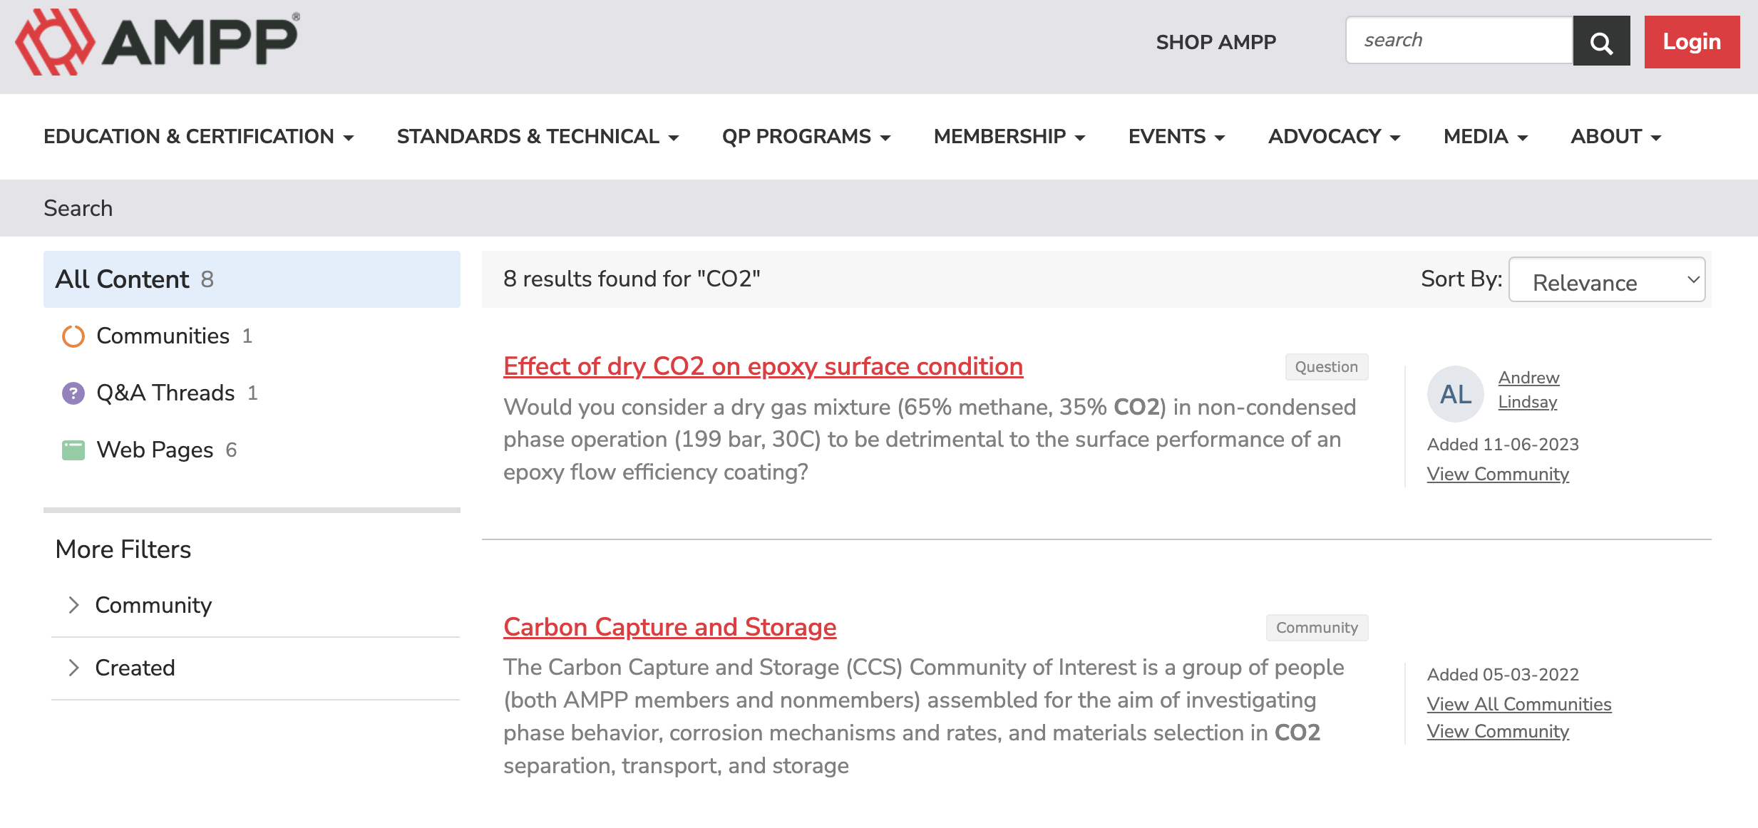
CO₂ testing (other organizations)
AMPP (Association for Materials Protection and Performance)

Slide 29
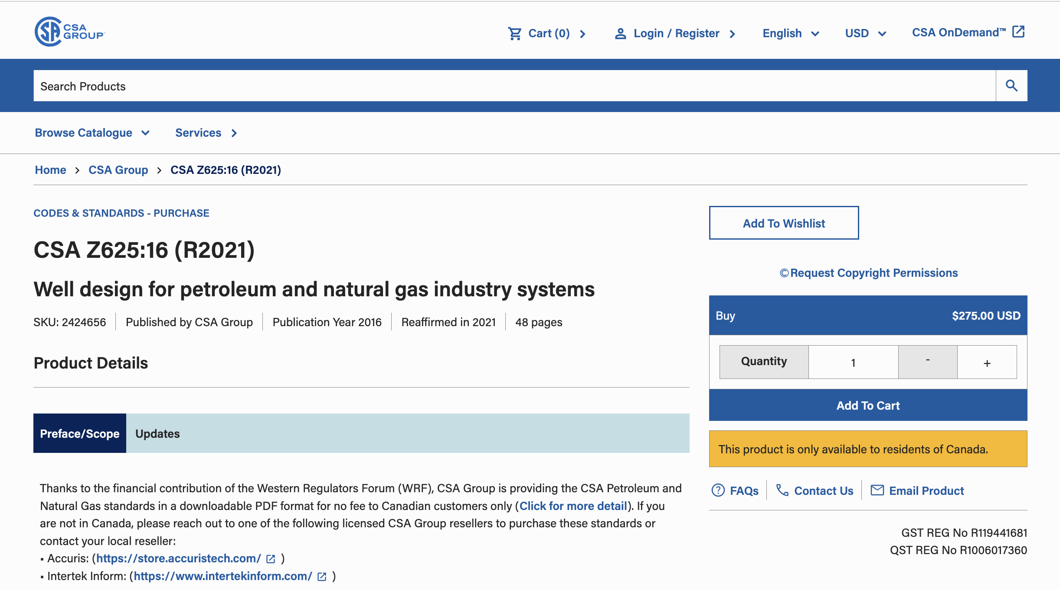

CO₂ testing (other organizations)
CSA GROUP

Slide 30

CO₂ testing (other organizations)
ISO 27916

Slide 31
API testing for H₂S
There is no API RP or exclusive TR to test cement resistance to H₂S. However, H₂S resistance is indirectly approached through specifications of sulfate resistant cements and general cement testing protocols.
Service companies, operators and research institutions lean on:
Exposure tests in autoclave machines with H₂S rich gas mixtures;
Long immersion of set cement in sulfide brines;
Petrographic analysis, SEM and XRD of set cement degration;
Strength and permeability testing after exposure to H₂S / sulfate brines;
Special binding materials (for exemple: pozzolanic mixtures, Classe G + silica fume, latex modified systems...)

Slide 32
API Specifications - Sulfate Resistance
API cement graduation in respect to sulfate resistance:
O (ordinary )
MSR (moderate sulfate resistance to SO₄)
HSR (high sulfate resistance)

Slide 33
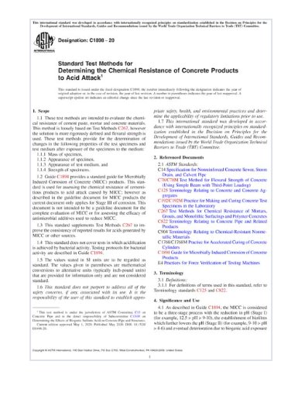
H2SO4 testing (other organizations)
ASTM C1898-20
Standard Test Methods For Determining The Chemical Resistance Of Concrete Products To Acid Attack
These test methods are intended to evaluate the chemical resistance of cement paste, mortar and concrete materials. This method is loosely based on Test Methods C267, however the solution is more rigorously defined and flexural strength is used. These test methods provide for the determination of changes in the following properties of the test specimens and test medium after exposure of the specimens to the medium:
Mass of specimen
Appearance of specimen,
Appearance of test medium, and
Strength of specimens.

Slide 34
Integrity Threat : Mechanical Failure
Effects: Microcracks, debonding, microannulus
Solutions: Flexible/self-healing cement, FEM analysis

Slide 35
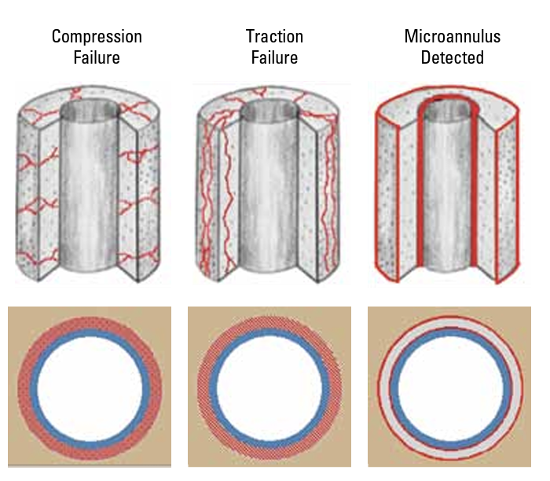
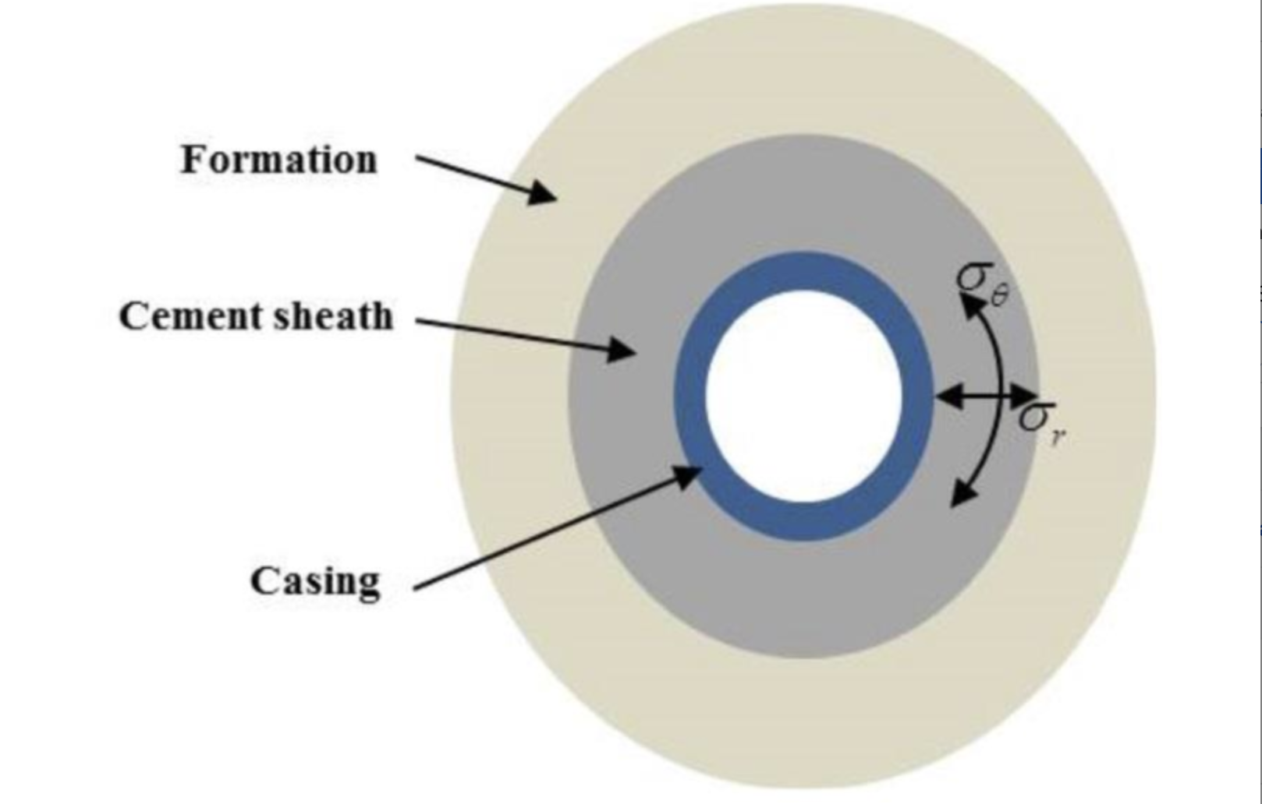
Integrity Threat : Mechanical Failure
Notes:
The gas flow model is used for evaluating and testing cement slurries for use in oil and gas well applications where the cement slurry in the annulus between casing and formation is exposed to a high-pressure permeable gas zone and to a lower pressure permeable zone.
The hydrostatic pressure of the fluid on top of the cement plus the hydrostatic pressure of the liquid cement will prevent gas invasion from occurring. During the cement hydration process, the hydrostatic pressure on top of the slurry is relieved thus reducing the cement pore pressure. As the cement sets, the cement pore pressure can allow gas to enter the cement column. The gas can migrate in to the well and to the surface and may cause a blowout or gas can communicate to a lower pressure permeable zone resulting in an internal blowout. The gas flow model will simulate this second scenario as described above.
A steel cylinder is used to contain the cement slurry and to simulate the cement in the annulus. Three pressures are applied to the cement slurry during the test:
Pressurized mineral oil simulates the hydrostatic pressures of different fluids, like drilling mud or cement spacer.
Nitrogen gas is injected into the cement slurry, a mesh screen will simulate the pressure permeable gas zone
Back pressure on the system is adjusted through a control valve
The third pressure is applied with the use of a back-pressure regulator. A fluid loss screen in conjunction with the back-pressure simulates the low-pressure permeable zone. Cement slurries can be tested at bottom hole temperature for fluid loss, transition time and the permeability of the set cement to resist gas invasion.

Slide 36


Integrity Threat : Mechanical Failure by Fracturing
High rate and high pressure pumping, injecting frac fluids into the formation, creating fractures...
After the fractures are created, sustaining agents, also called proppants, are pumped in...
The fracture is filled in by proppants, at the end of the pumping, in order to keep it open and to facilitate fluids from the reservoir to the well.
△P
Pressure Cycling

Slide 37
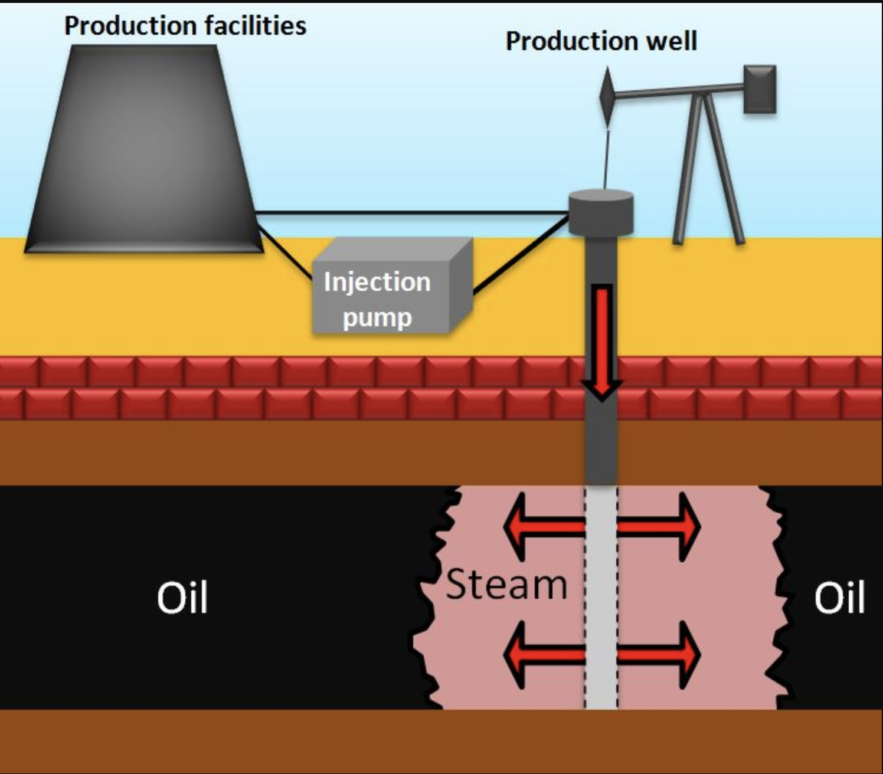
Integrity Threat : Mechanical Failure By Steam Injection
△T

Slide 38

Integrity Threat : Mechanical Failure By CO₂ Injection
CO₂ injection is a proven EOR technique (± 45 years);
Injected CO₂ reduces oil viscosity and interfacial tension;
Under high pressure, CO₂ becomes miscible with oil, improving recovery;
It helps to keep reservoir pressure and improves oil sweep efficiency;
Recovery increases by 10 to 20% or more in comparison with water injection;
Captured industrial CO₂ can be reutilized, contributing to carbon management;
Importance to set cement: wells should keep integrity when exposed to CO₂.

Slide 39
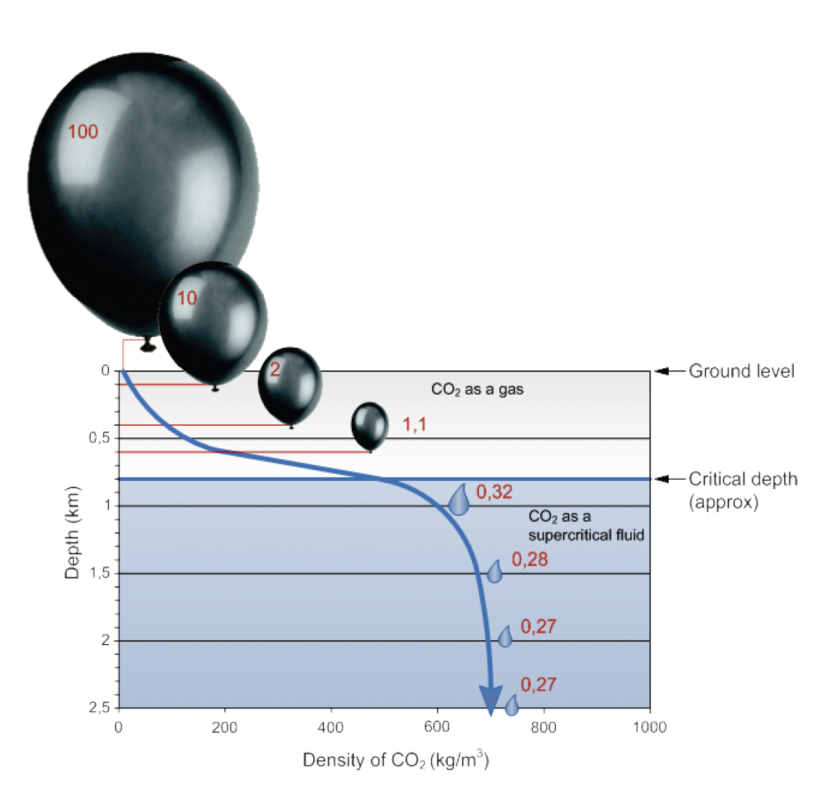
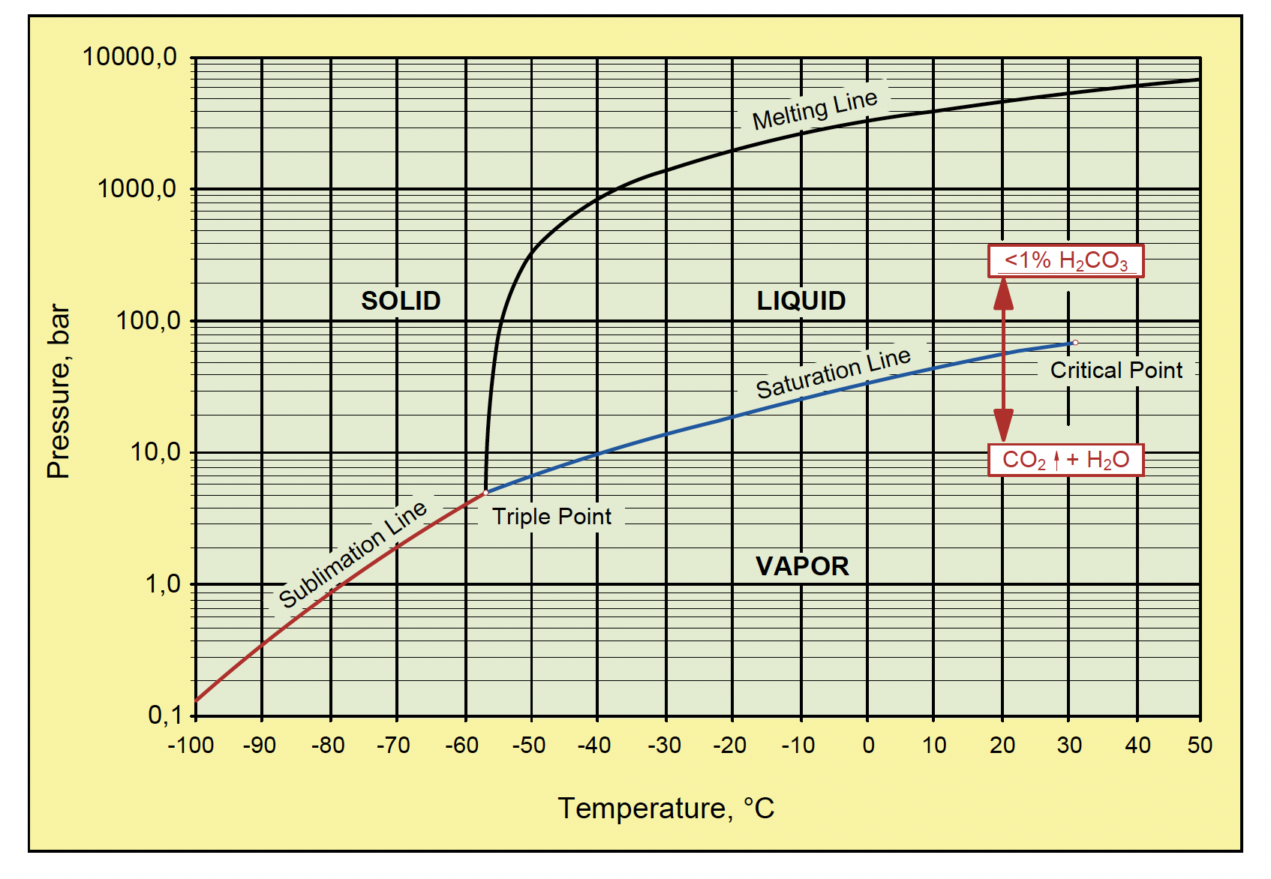
Integrity Threat : Mechanical Failure By CO₂ Injection
CCS (± 10 anos)
IEA, 2008
Notes:
In the last 10 years, most of the technologies developed through the last 44 years of CO₂ EOR experience have been successfully applied in GS (geologic sequestration) for CCS (carbon capture and storage) in saline aquifers (Sweatman et al., 2009). To date, the technology as a whole has only been deployed so far at a few pilot sites around the world such as the Sleipner field in Norway, Weyburn field in Canada, in Salah field in Algeria (Gallo et al., 2002, Jimenez and Chalaturnyk, 2002). The majority of locations that are being considered for carbon dioxide (CO₂) injection and sequestration are typically found in the areas that have a history of oil, natural gas, and/or coalbed methane production (Ennis- King and Paterson, 2002; Gallo et al., 2002; Nezhad et al., 2006; Bellarby, 2009). Due to well logging and exploration activities in these regions, there is also a greater knowledge base for saline formations that lie either above or below oil and gas reservoirs. As a result of human activity, these formations are typically punctured by a significant number of wells from both exploration and production. No matter how impermeable an overlying caprock is, the sealing integrity may be compromised by the presence of wells. Diffusion through the cap rock is normally less of a concern than fracturing or fault-related leakage (Jimenez and Chalaturnyk, 2002).

Slide 40
Integrity Threat : Mechanical Failure By Stimulation
Acid stimulation fluids, especially hydrochloric acid (HCl), can cause serious damage to set cement if they come into contact with it. Here’s what happens:
⁠ ⁠Dissolution of Cement Phases
HCl aggressively reacts with Ca(OH)₂ and other cement hydrates, such as calcium silicate hydrate (C–S–H), which are key to the strength of set cement.
This leads to decalcification, weakening the cement structure.
⁠Increase in Porosity and Permeability
As acid dissolves cement compounds, it opens up the cement matrix, increasing porosity and permeability.
This compromises the sealing capability of the cement, potentially allowing fluid migration along the annulus.
HCI

Slide 41
Integrity Threat : Mechanical Failure By Stimulation
⁠Strength Loss
Progressive acid attack leads to loss of compressive strength, making the cement sheath unable to withstand pressure or mechanical loads.
⁠Zonal Isolation Failure
Damaged cement can lead to zonal isolation failure, resulting in crossflow between formation layers, gas migration, or sustained casing pressure (SCP).
Risk of Well Integrity Compromise
In severe cases, acid-induced degradation of cement jeopardizes overall well integrity, requiring expensive remediation or re-cementing.
HCI

Slide 42
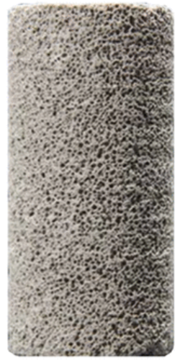
Integrity Threat : Early Gas Migration
Tests: Static gel strength, thixotropy behavior
Design: Accelerators, latex, foam, proper centralization
Foam Cement

Slide 43
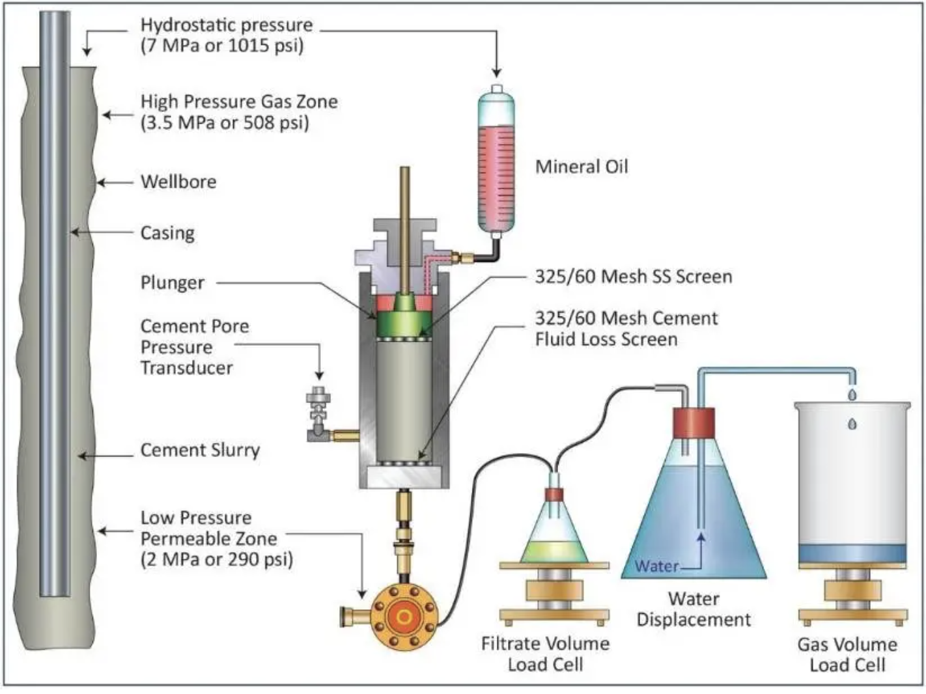

Integrity Threat : Early Gas Migration
Gas influx / migration test
Static Gel Strength Analyzer
Notes:
The gas flow model is used for evaluating and testing cement slurries for use in oil and gas well applications where the cement slurry in the annulus between casing and formation is exposed to a high-pressure permeable gas zone and to a lower pressure permeable zone.
The hydrostatic pressure of the fluid on top of the cement plus the hydrostatic pressure of the liquid cement will prevent gas invasion from occurring. During the cement hydration process, the hydrostatic pressure on top of the slurry is relieved thus reducing the cement pore pressure. As the cement sets, the cement pore pressure can allow gas to enter the cement column. The gas can migrate in to the well and to the surface and may cause a blowout or gas can communicate to a lower pressure permeable zone resulting in an internal blowout. The gas flow model will simulate this second scenario as described above.
A steel cylinder is used to contain the cement slurry and to simulate the cement in the annulus. Three pressures are applied to the cement slurry during the test:
Pressurized mineral oil simulates the hydrostatic pressures of different fluids, like drilling mud or cement spacer.
Nitrogen gas is injected into the cement slurry, a mesh screen will simulate the pressure permeable gas zone
Back pressure on the system is adjusted through a control valve
The third pressure is applied with the use of a back-pressure regulator. A fluid loss screen in conjunction with the back-pressure simulates the low-pressure permeable zone. Cement slurries can be tested at bottom hole temperature for fluid loss, transition time and the permeability of the set cement to resist gas invasion.

Slide 44
Integrity Threat : Cement Design
Poorly designed cement jobs may lead to catastrophic failures on well integrity
Mitigation: the use of simulators, adequate cement systems and mud removal techniques, tailored to well conditions

Slide 45
Cement Design
Expandable systems
Lightweight/foamed cements
Self-healing additives
Compatibility with formations (salt, shale, fractured zones)
Environmental stewardship (bio-based additives, recycled byproducts, and low-carbon cement alternatives)

Slide 46
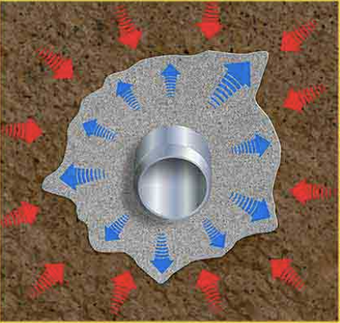
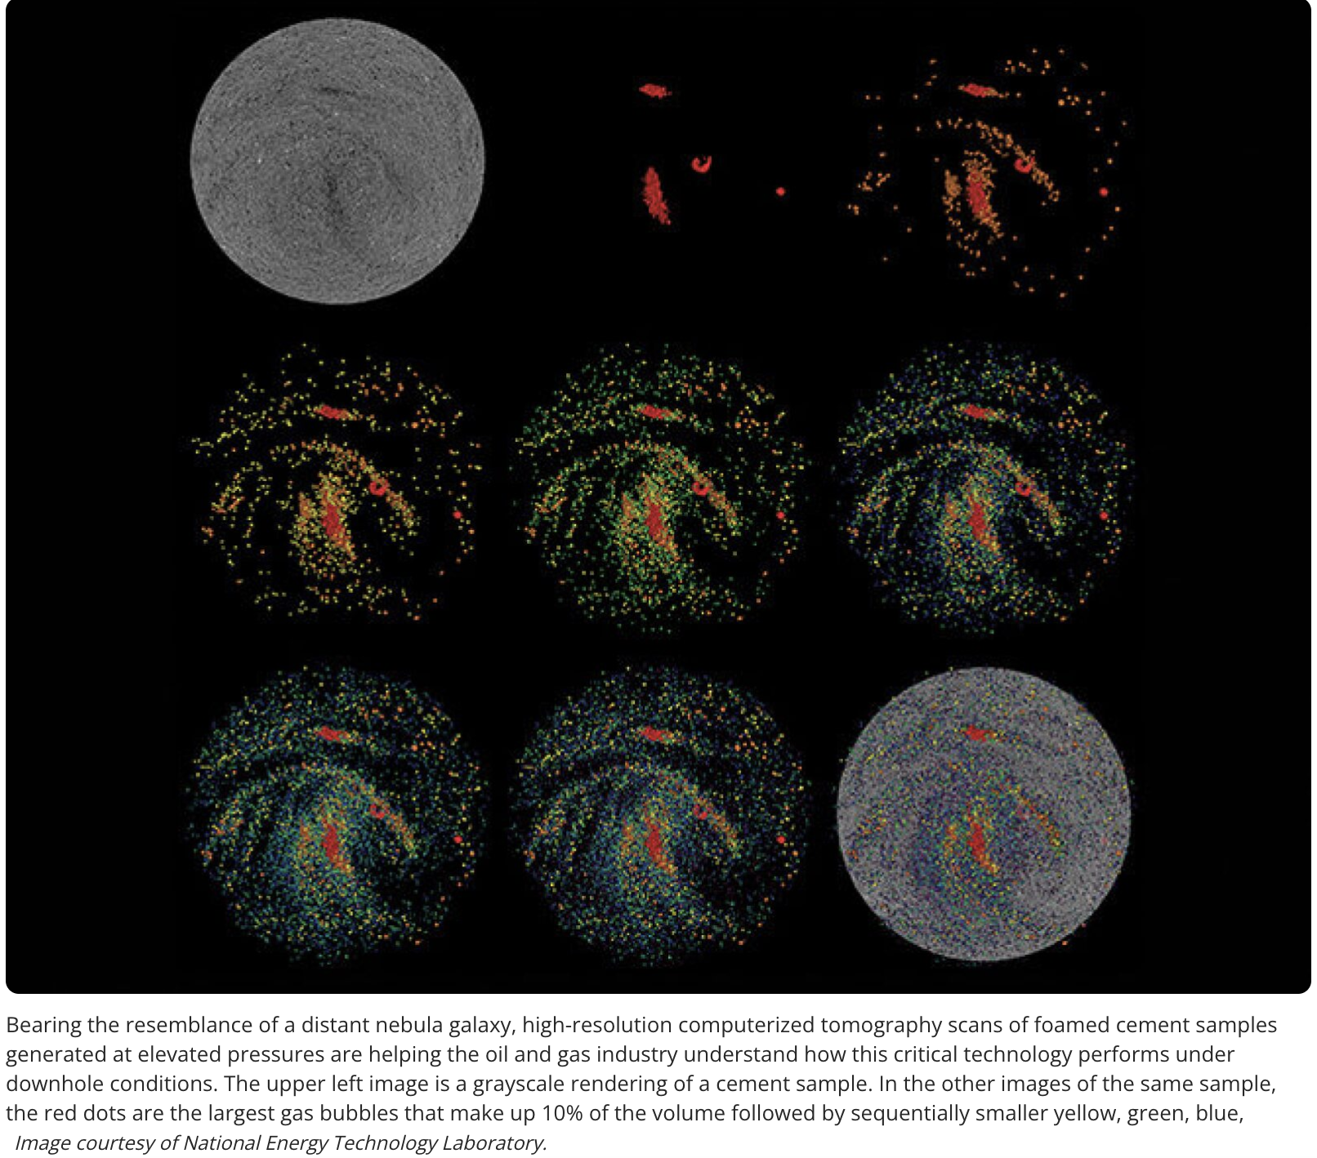
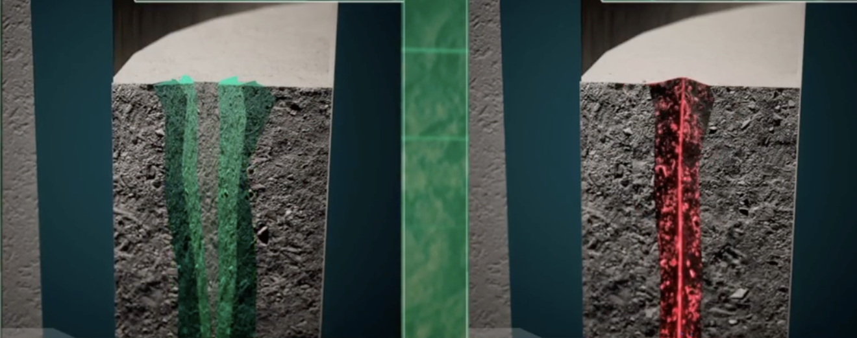
Cement Design
Flexible Cement
Foamed Cement
Self-healing Cement

Slide 47
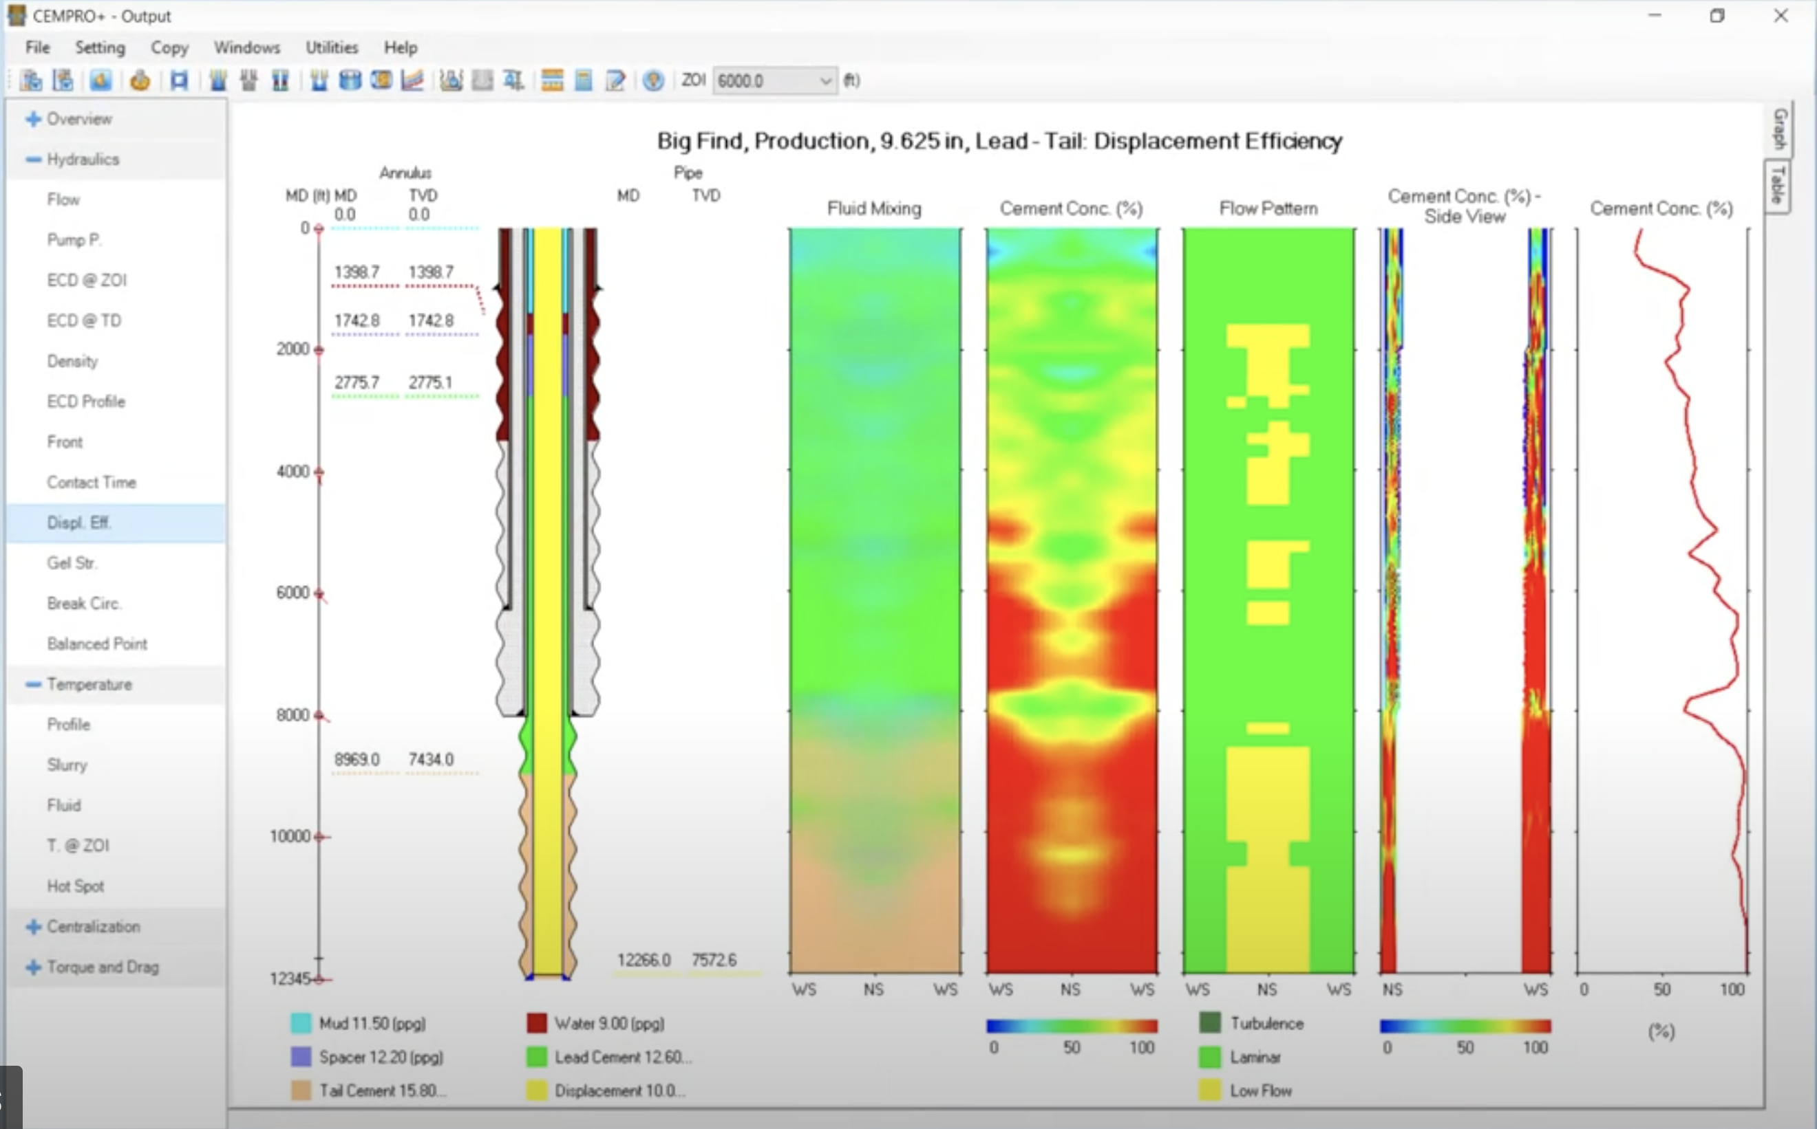
Cement Design Simulators
Sources:
Service companies;
Independent specialized software companies.

Slide 48
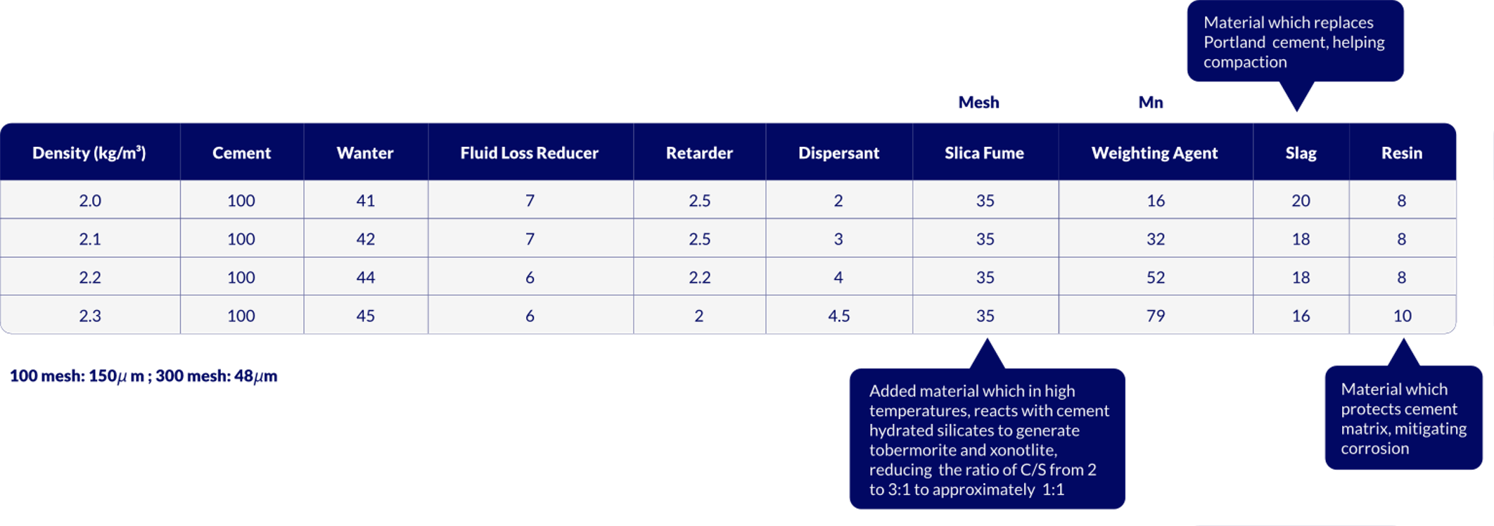
Cement Design
Composition of high-density cement slurries. Unit wt. %.
180º C

Slide 49
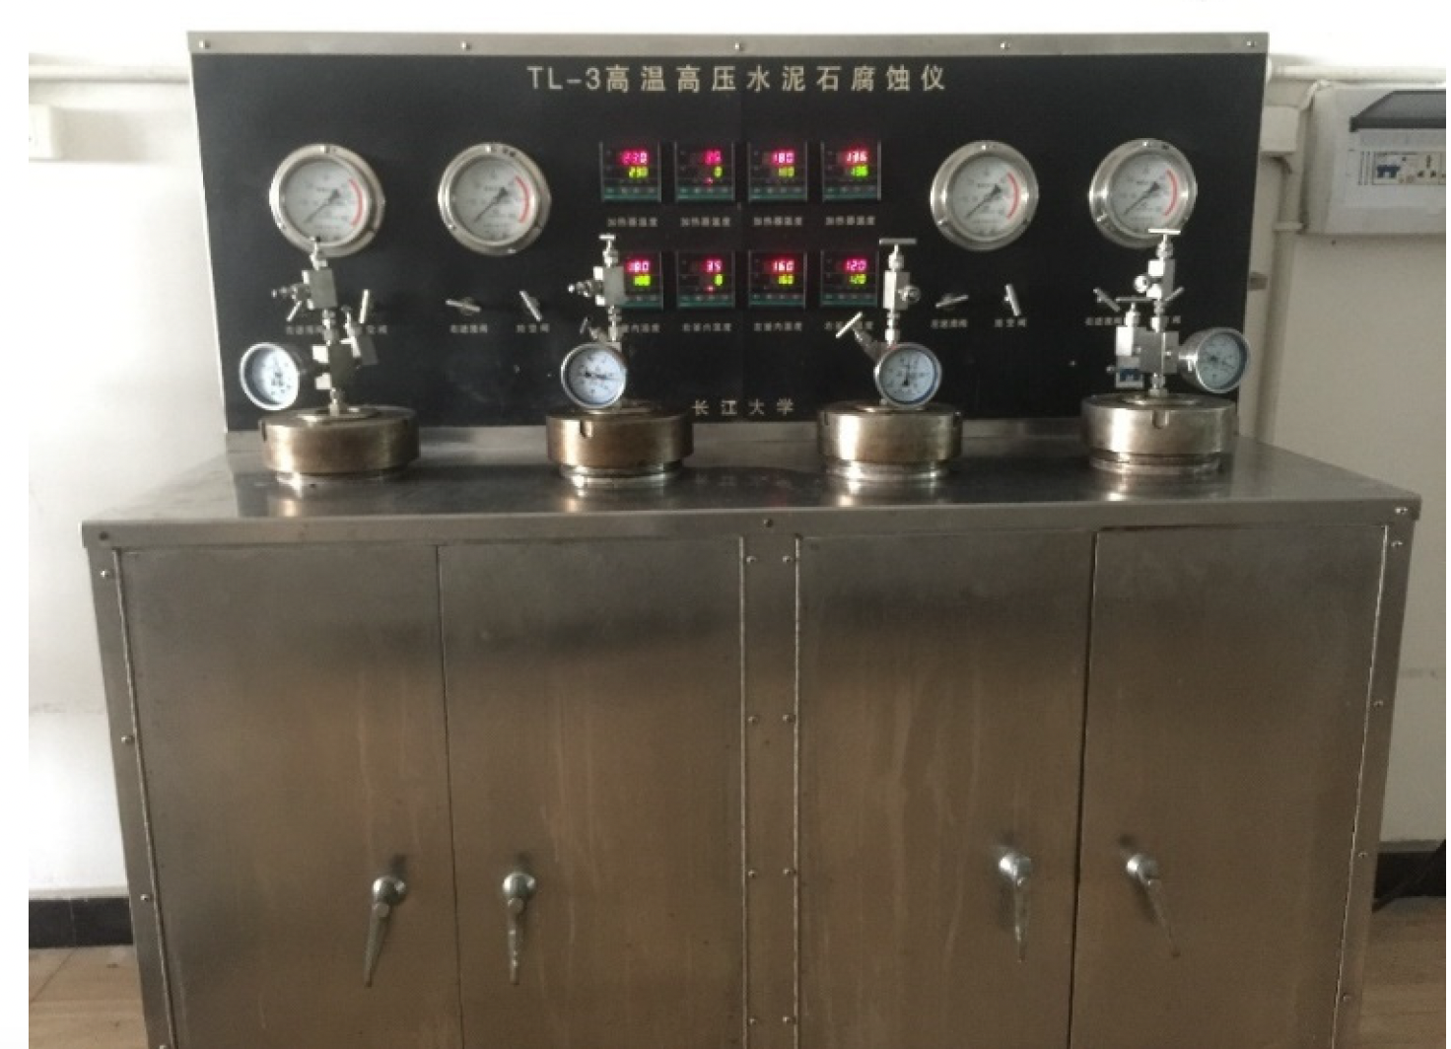
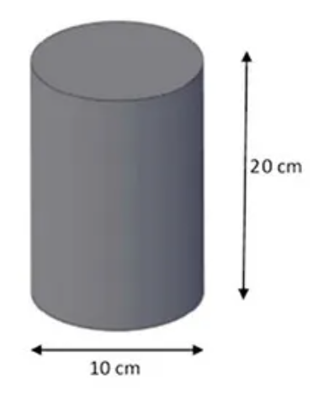
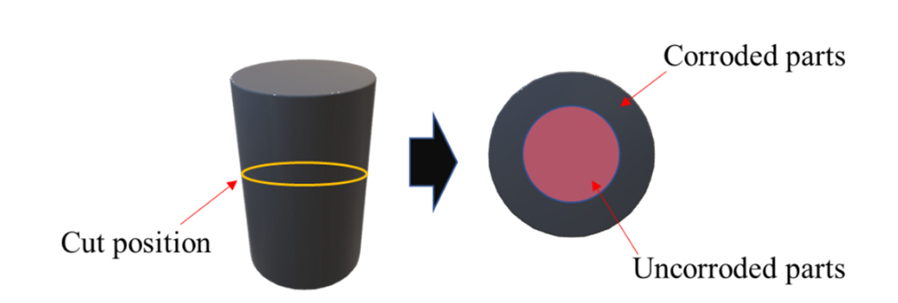
Cement Design
25 mm
The cement cylinders were retrieved after 7 and 30 days for evaluation
30 Mpa = 4.350 psi
180ºC
25 mm
Most integral part = alcaline region (presence of Ca), indicated by phenolphetalein coloration (red)

Slide 50
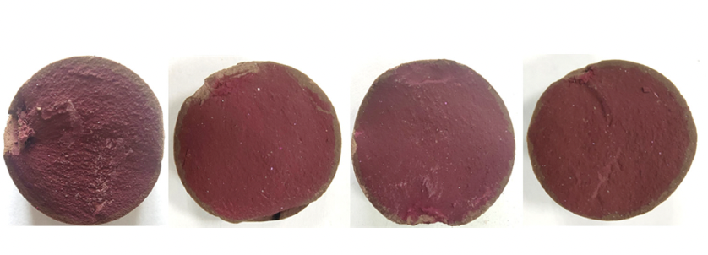
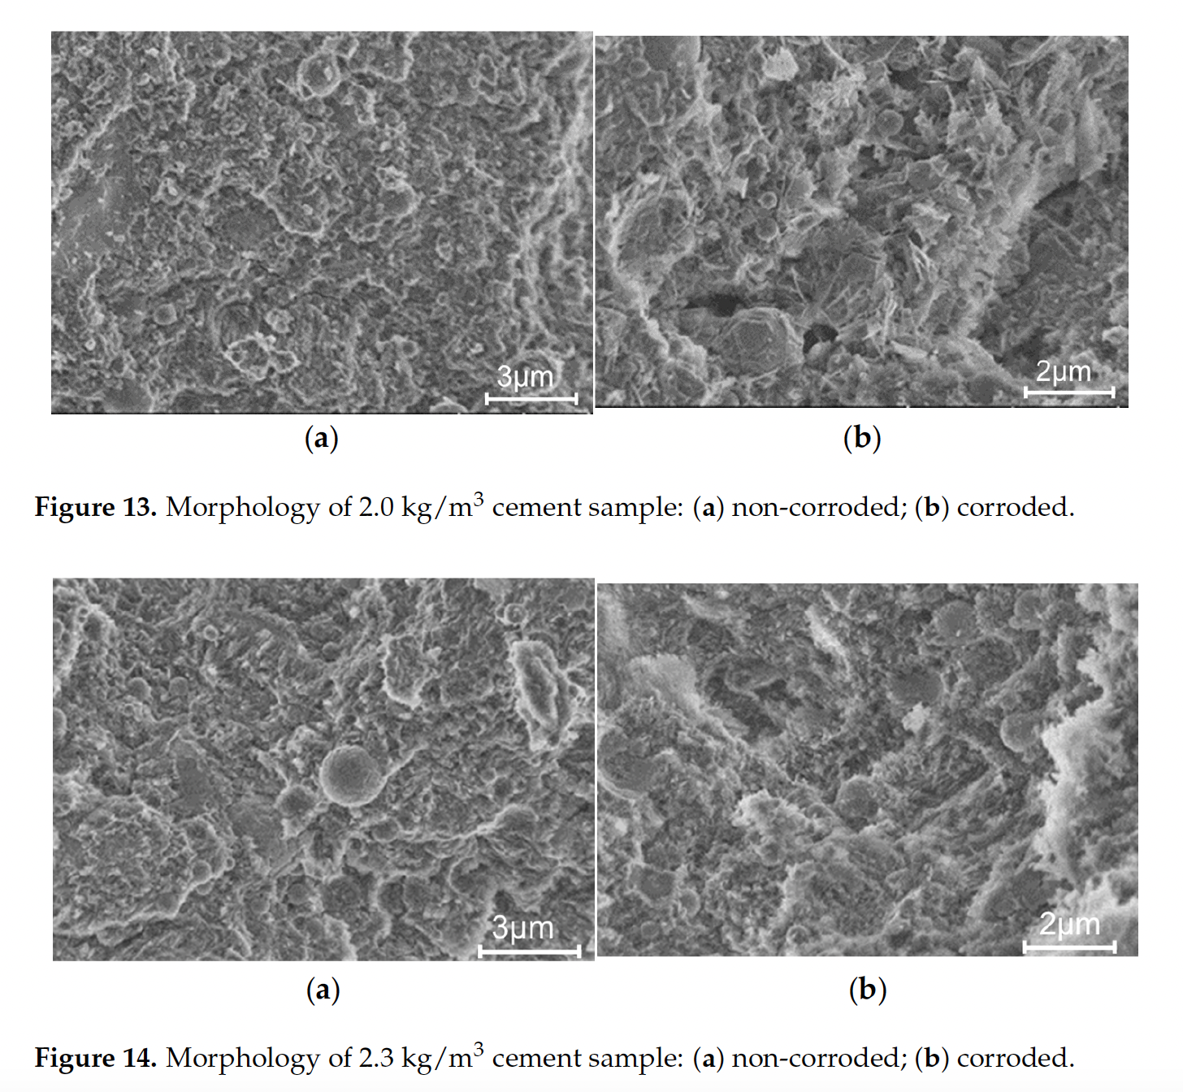
Cement Design

Slide 51
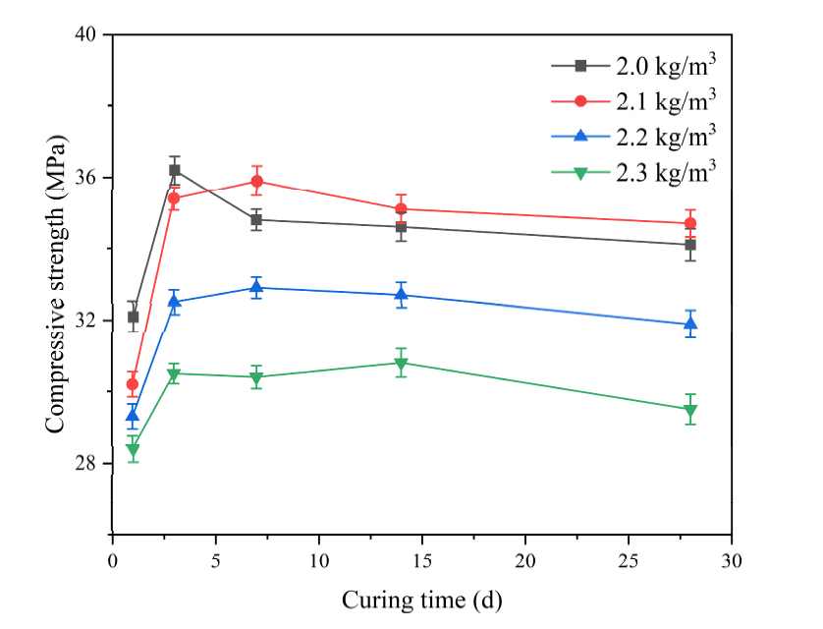
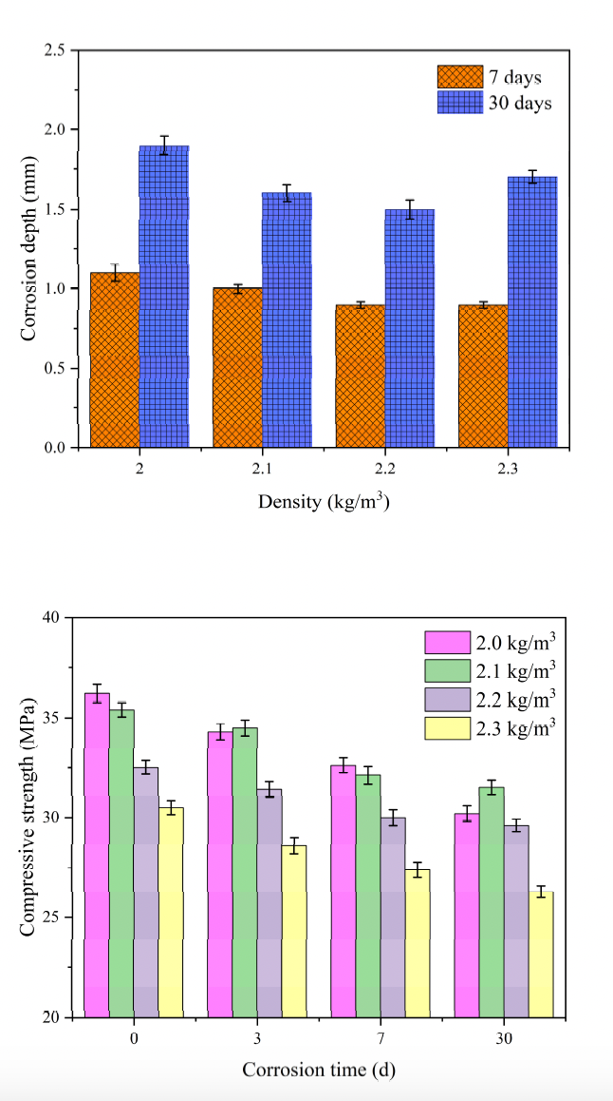
Cement Design

Slide 52
Cement Evaluation Tools Overview
CBL (Cement Bond Log)
Ultrasonic (USIT / Isolation Scanner)
Pulsed Neutron Logs (PNL)
Fiber Optics (DAS/DTS)
Temperature & Pressure Surveys
Notes:
CBL (Cement Bond Log): Measures amplitude of casing arrivals.
VDL (Variable Density Log): Provides waveform visualization for interpretation.
Limitations: Cannot distinguish between partial bond and gas-cut cement.
Ultrasonic Imaging Tools
USIT (Ultrasonic Imaging Tool) / CAST-V / Isolation Scanner:
Measure acoustic impedance (Z = ρ × V).
Provide cement thickness maps and bond quality.
Better for lightweight or gas-contaminated cement.
3Pulsed Neutron Logs (PNL)
Post-perforation logs to evaluate cement behind pipe.
Sensitive to formation saturation, but can infer cement density indirectly.
Fiber Optic Sensing (DAS/DTS = Distributed Acoustic and Temperature Sensing) for real time leak and flow detection
The combination of DAS and DTS can offer both qualitative and quantitative information regarding fluid dynamics in the context of well integrity investigation, as the flow characteristics (intensity of turbulences). Can be permanently installed in subsea and high risk wells
Pressure and Temperature Surveys Used for identifying annular pressure communication, leaks or microannuli Temperatures logs can reveal fluid migration pathways post cementing

Slide 53
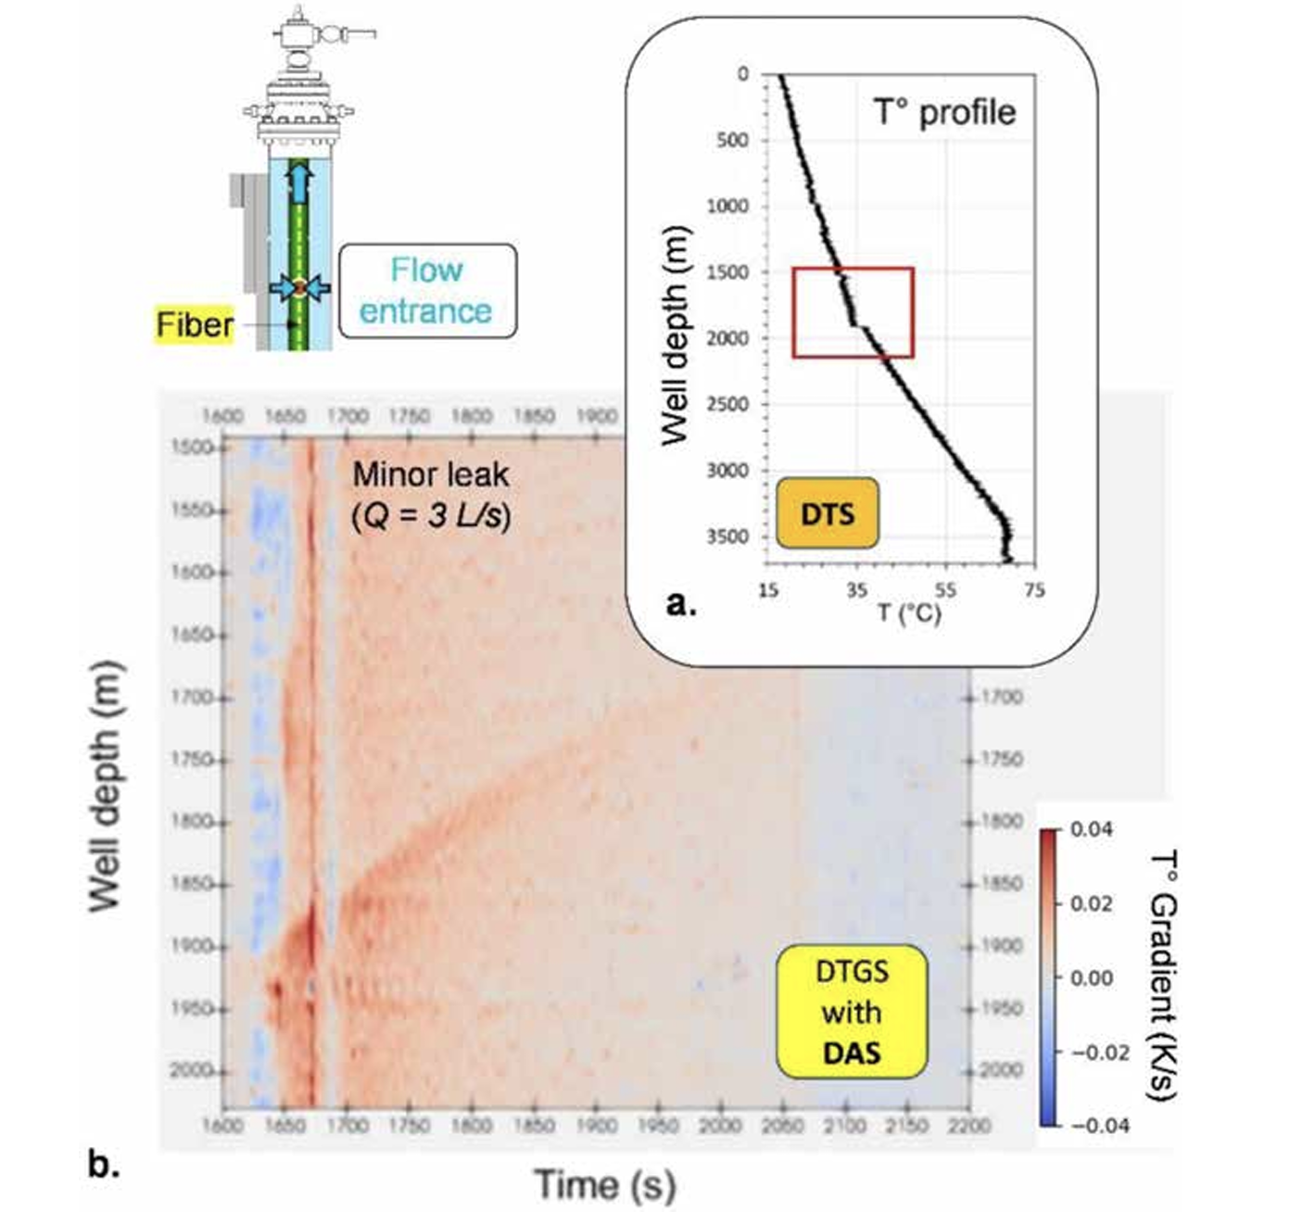
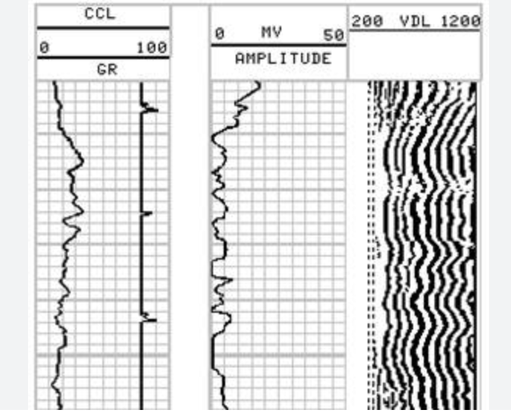
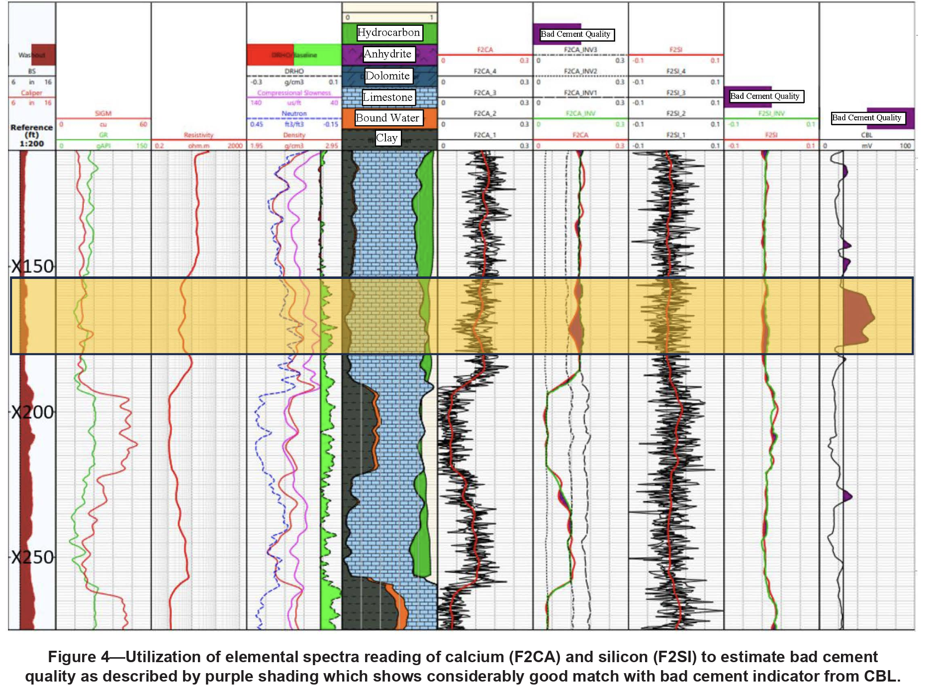
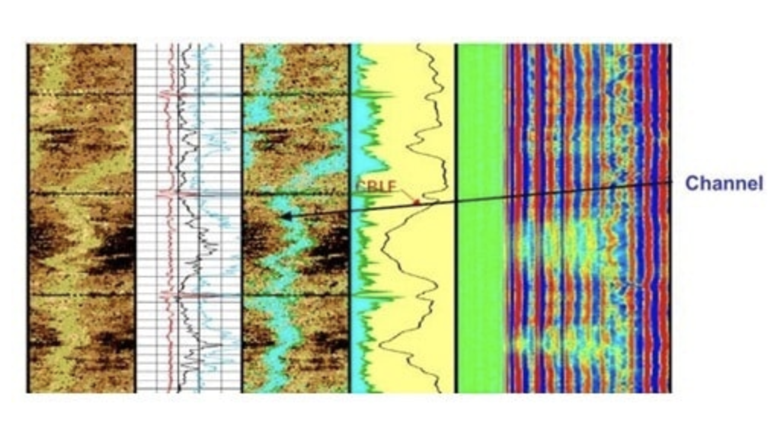
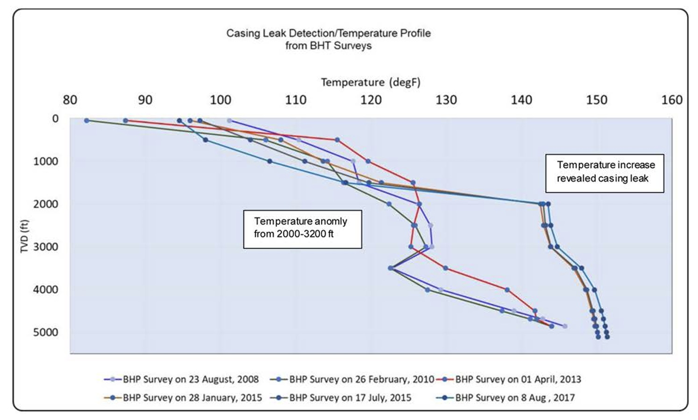
Cement Evaluation Tools Overview
CBL & VDL
Pulse Neutron Logs
Fiber Optics Sensing
USIT
Pressure & Temperature Sureveys
Notes:
CBL (Cement Bond Log): Measures amplitude of casing arrivals.
VDL (Variable Density Log): Provides waveform visualization for interpretation.
Limitations: Cannot distinguish between partial bond and gas-cut cement.
Ultrasonic Imaging Tools
USIT (Ultrasonic Imaging Tool) / CAST-V / Isolation Scanner:
Measure acoustic impedance (Z = ρ × V).
Provide cement thickness maps and bond quality.
Better for lightweight or gas-contaminated cement.
3Pulsed Neutron Logs (PNL)
Post-perforation logs to evaluate cement behind pipe.
Sensitive to formation saturation, but can infer cement density indirectly.
Fiber Optic Sensing (DAS/DTS = Distributed Acoustic and Temperature Sensing) for real time leak and flow detection
The combination of DAS and DTS can offer both qualitative and quantitative information regarding fluid dynamics in the context of well integrity investigation, as the flow characteristics (intensity of turbulences). Can be permanently installed in subsea and high risk wells
Pressure and Temperature Surveys Used for identifying annular pressure communication, leaks or microannuli Temperatures logs can reveal fluid migration pathways post cementing

Slide 54

Tool Comparison Table

Slide 55


Cement Integrity Monitoring Trends
Machine learning prediction of isolation failure
Smart cements (sensing materials, self-healing)
Permanent downhole sensors

Slide 56
Integration Strategy
Early Evaluation (while rig is on site)
Long-Term Surveillance (DTS, casing pressure)
Life-cycle Integrity Plan

Slide 57

Final Thoughts
Evaluation must match design and environment
Digital tools and smart cements are the future

Slide 58
Thank You!

Slide 59

Investigation of well integrity of a 33 years old offshore well in Norway
69 m water depth
Well design showing the location of sections. In purple the twenty three recovered sections
and in red the two sections, our object of study.

Slide 60

Investigation of well integrity of a 33 years old offshore well in Norway

Slide 61


Investigation of well integrity of a 33 years old offshore well in Norway
Table 1 – Sandwich sections under study

Slide 62

Investigation of well integrity of a 33 years old offshore well in Norway
CT: Computer Tomography Scanning | E: Young's Modulus | UCS: Uniaxial compressive strength | SEM: Scanning electron microscopy |
EDS: Energy dispersive spectroscopy | XRF: X-ray Fluorescence | XRD: X-ray Diffraction.

Slide 63

Investigation of well integrity of a 33 years old offshore well in Norway
Fish 11 FT 87
Transition Joint – TJ 48
Transition Joint – TJ 73

